Slide 1
Preview the 2021 Digital AP Exams

Slide 2
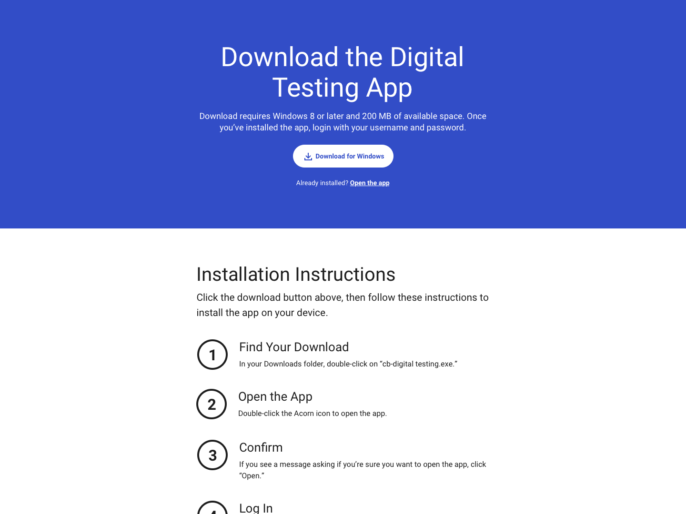
Before Exam Day: Download the App
In early April, AP students will be able to download our new digital testing app to their desktop or laptop computers (PC or Mac).
If you’re on a school-managed Chromebook, someone from your school will install the app for you.

Slide 3
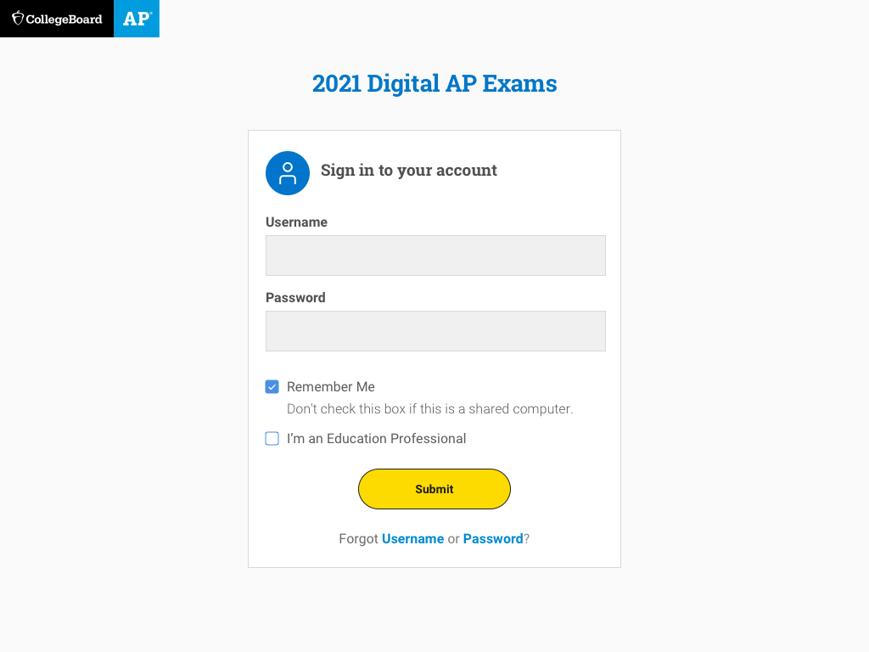
Before Exam Day: Log In
You’ll need your College Board username and password to use the app.
If you check Remember Me, you won’t need to log in each time you return.

Slide 4
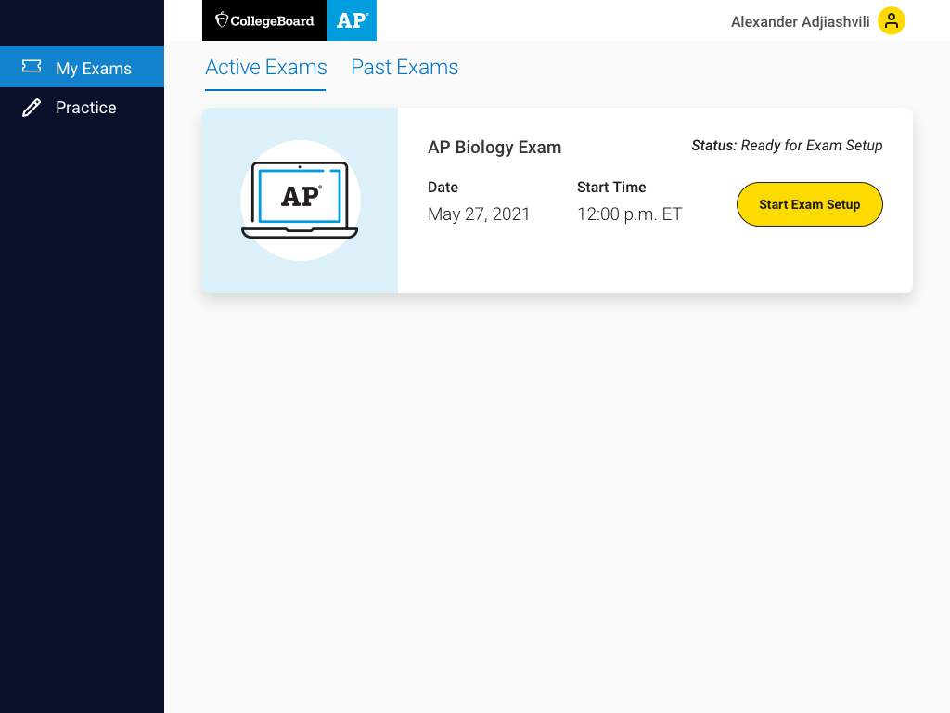
3 Days Before Test Day: Complete Exam Setup
3 days before your test, you’ll run through exam setup in the app where you’ll confirm some information about yourself and your device.
You must complete exam setup for every digital AP Exam you take, and it’s critical that you complete this step before test day.

Slide 5
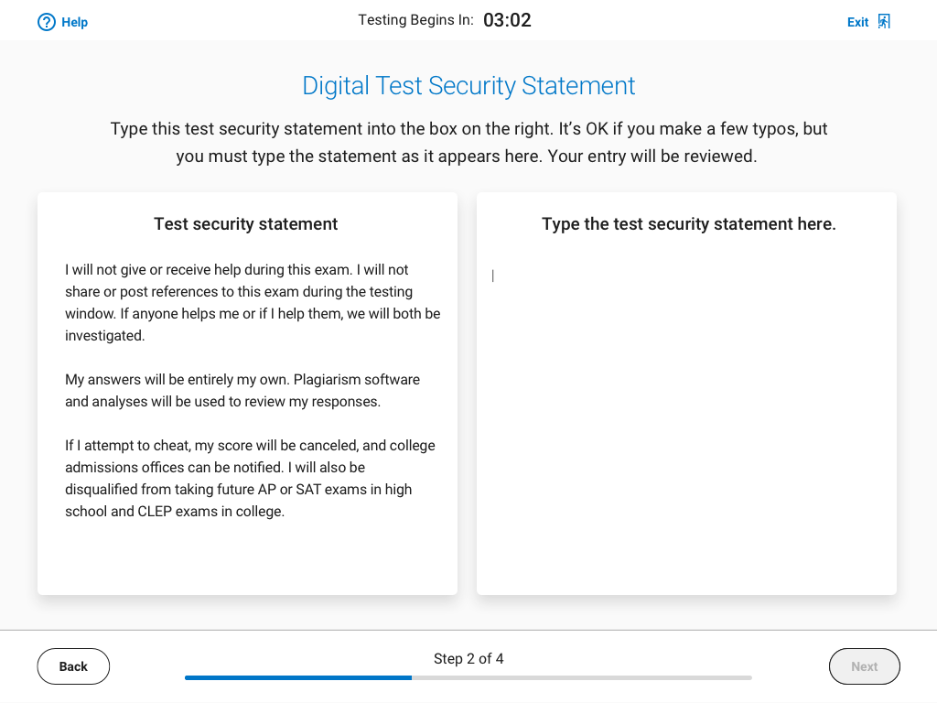
30 Minutes Before Your Exam: Check In
30 minutes before your exam’s start time, you’ll launch the app and check in for your exam.
You’ll review some privacy policies, type a security statement, and get ready to test.
It’s important that you check in on time. You won’t be able to check in once your exam starts.

Slide 6
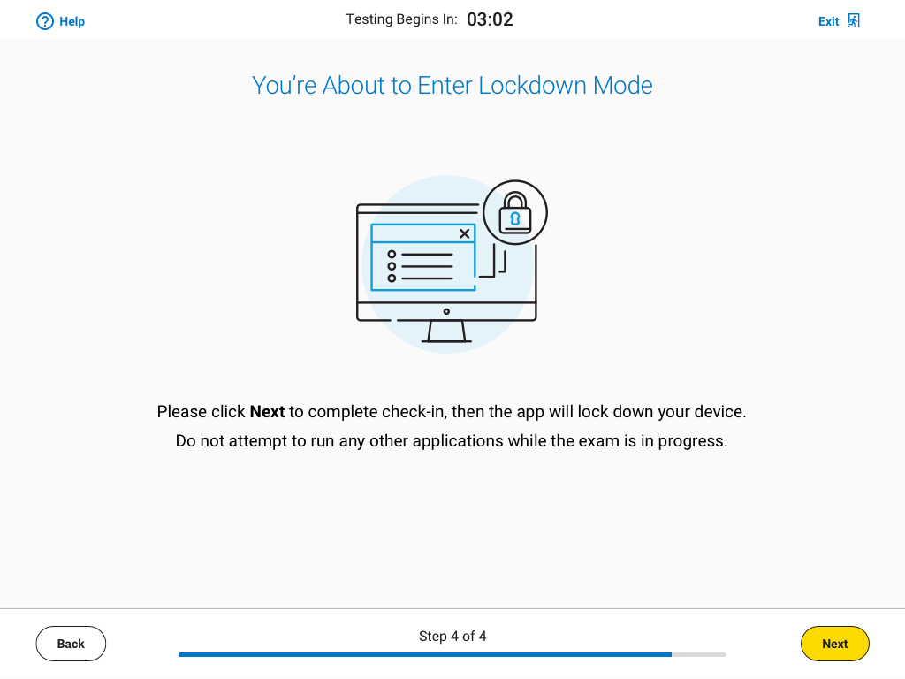
Lockdown Mode
Right before the exam begins, the app will lock your device. You’ll need to close all other applications before testing begins.

Slide 7
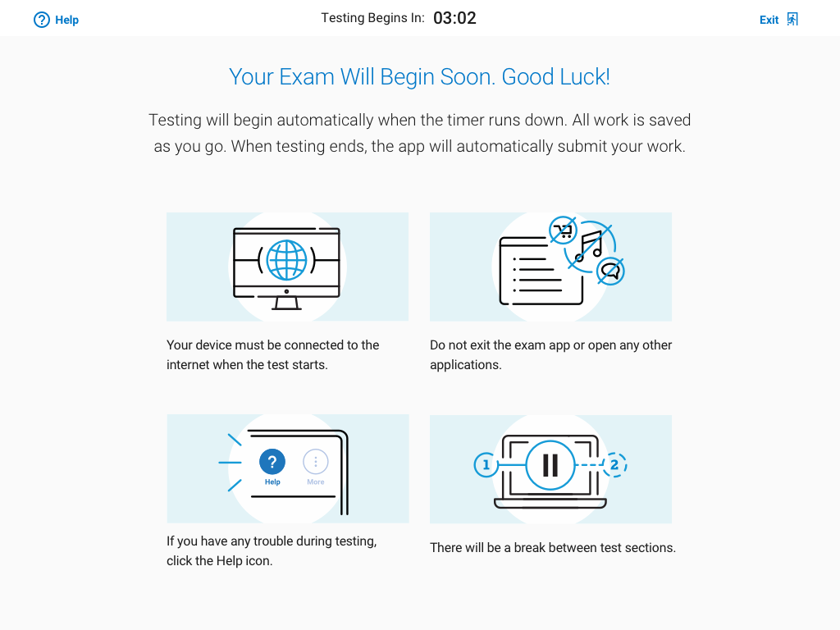
Digital Exams Start Automatically
If you finish check-in before your exam’s start time, you’ll see a timer counting down. When time expires, the exam will start automatically.

Slide 8
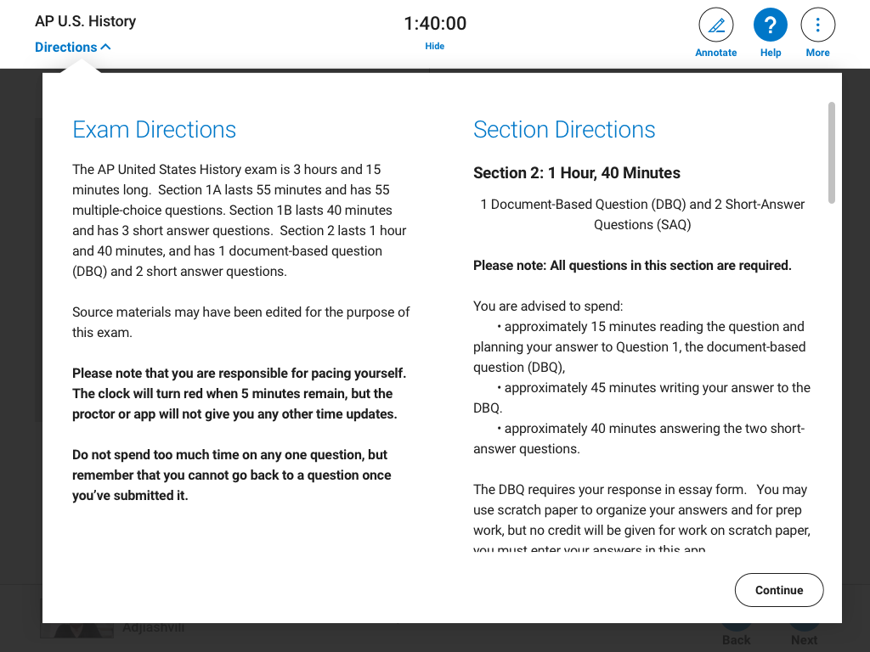
Testing Toolbar: Directions
At the top left of every testing screen, you can access general exam directions as well as section-specific directions.

Slide 9
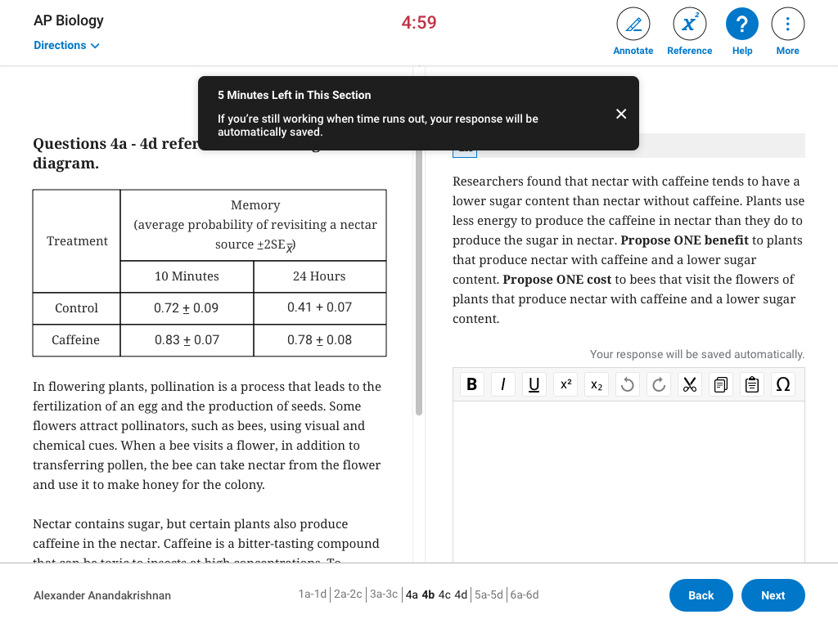
Testing Toolbar: Timer
During the exam, a timer will count down the time remaining for each section.
You can hide the timer, except during the last 5 minutes of a section.
Once time expires on the last section of the exam, your answers will be submitted automatically.

Slide 10
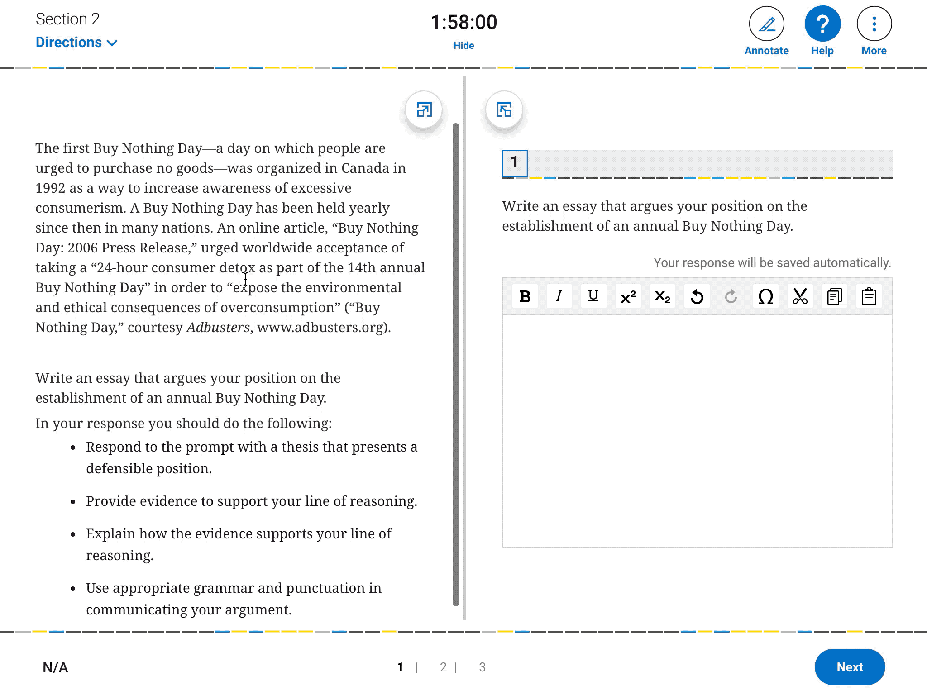
Testing Toolbar: Annotate
You can highlight any part of a passage or question that you might want to return to or leave yourself a note to organize your thoughts.

Slide 11
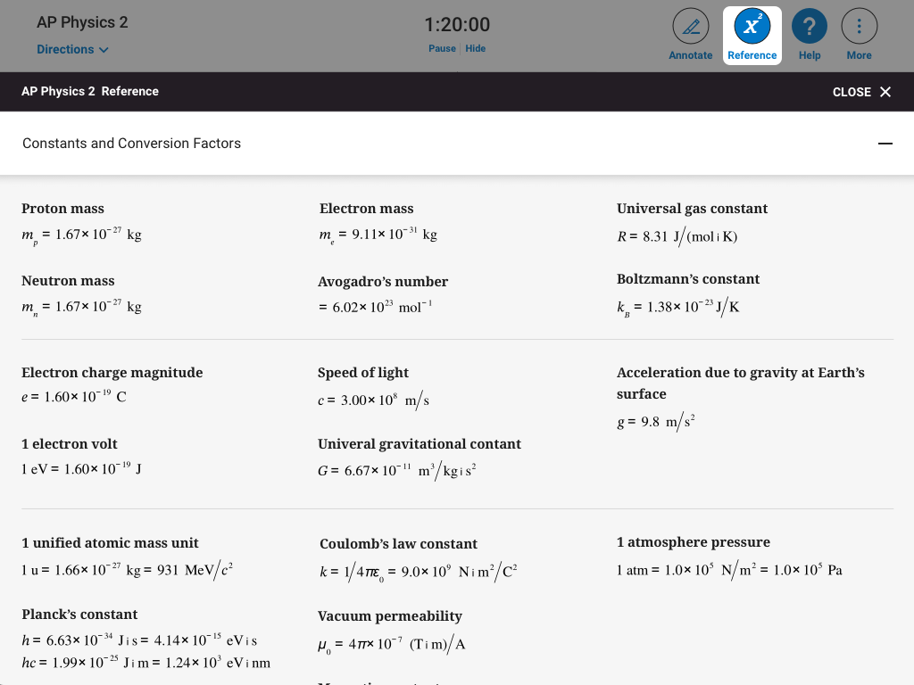
Testing Toolbar: Reference Sheet
In most STEM courses, you’ll have access to a reference sheet with commonly used formulas.
If your AP Exam requires or allows calculators, you must bring your own.

Slide 12
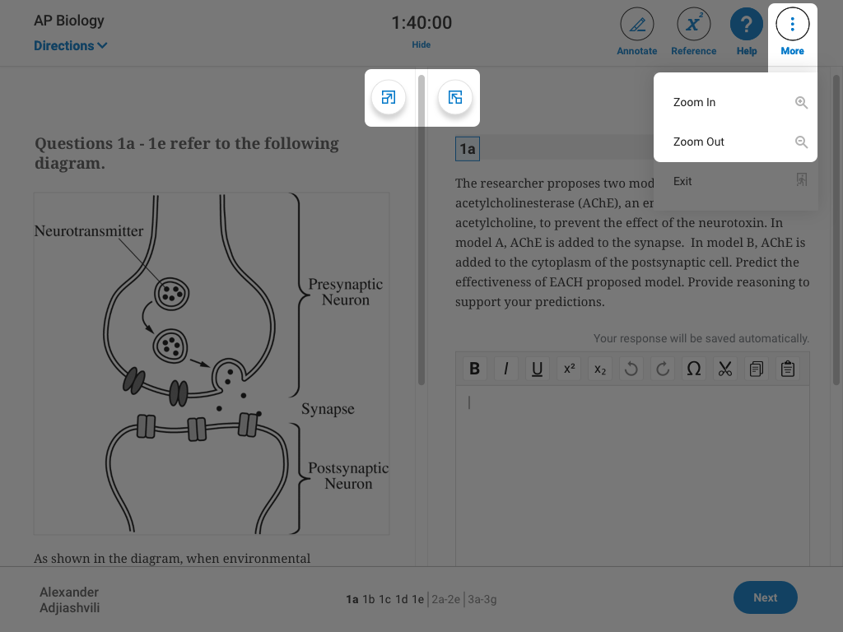
Testing Toolbar: Zoom and Expand
You can Zoom In and Zoom Out to get a closer look at any part of a question. You can find the Zoom In/Out buttons under More.
You can also make one side of the screen bigger than the other with the Expand Left or Expand Right controls.

Slide 13
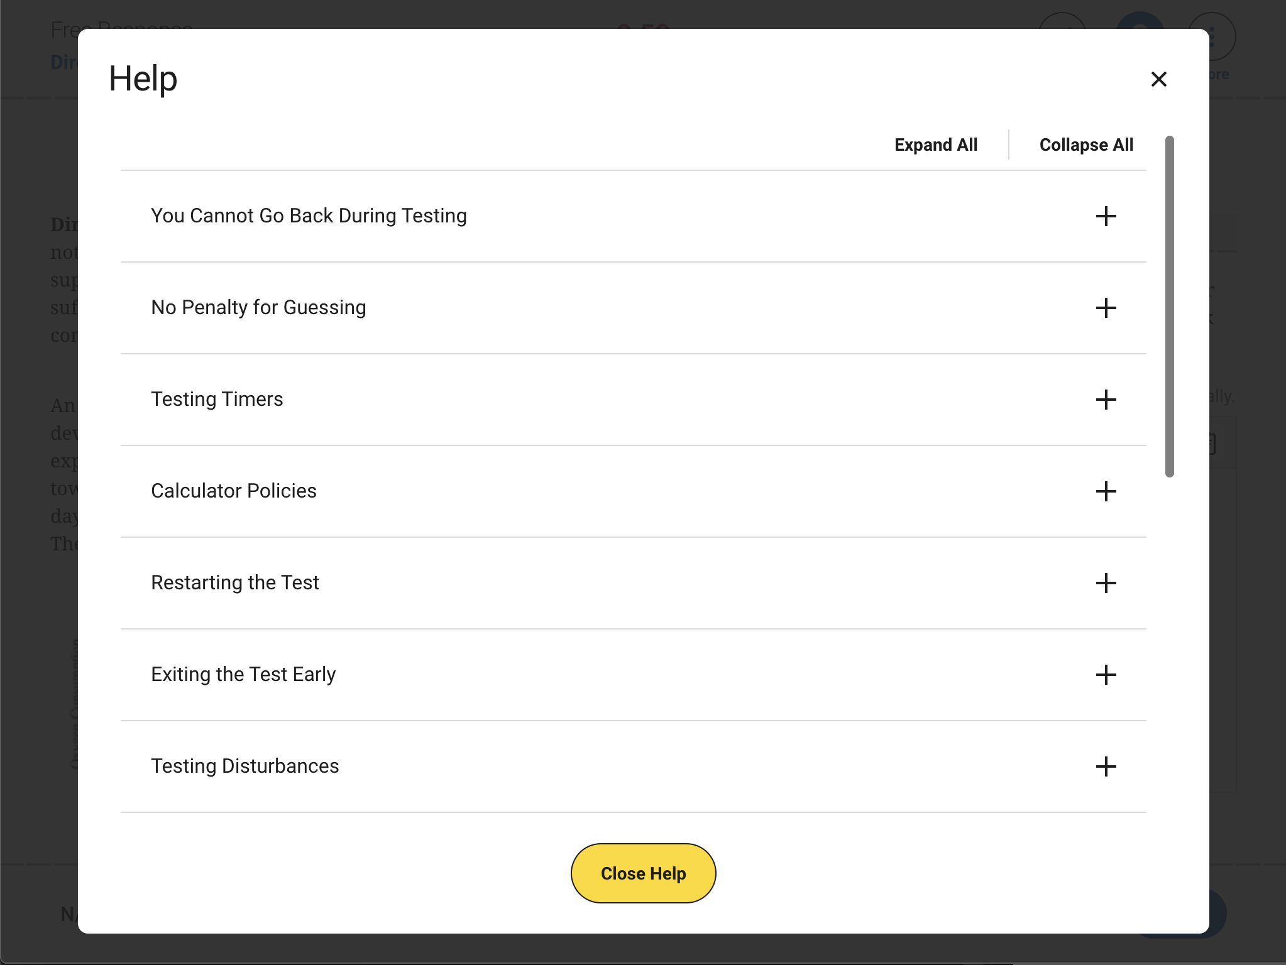
Testing Toolbar: Help
On every screen, you have access to a Help page where you can view frequently asked questions.

Slide 14
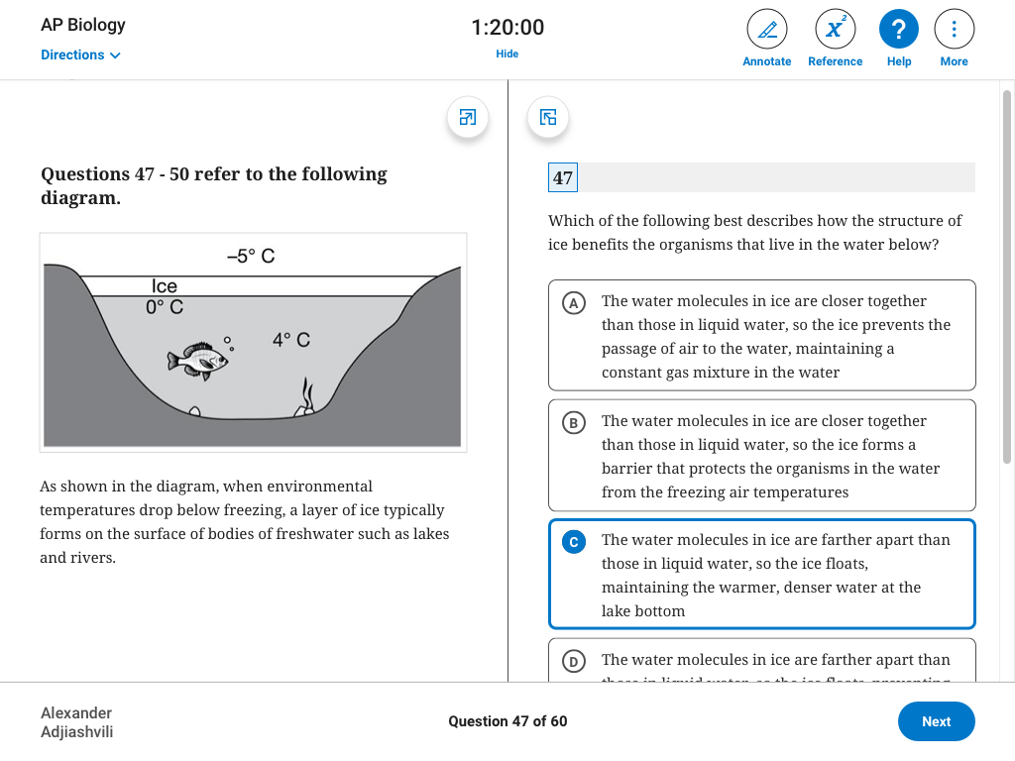
Multiple-Choice Questions
Most AP Exams are a combination of multiple-choice and free-response questions.
Some multiple-choice questions are centered on the screen while others have stimulus content on the left, and questions and answers on the right.

Slide 15
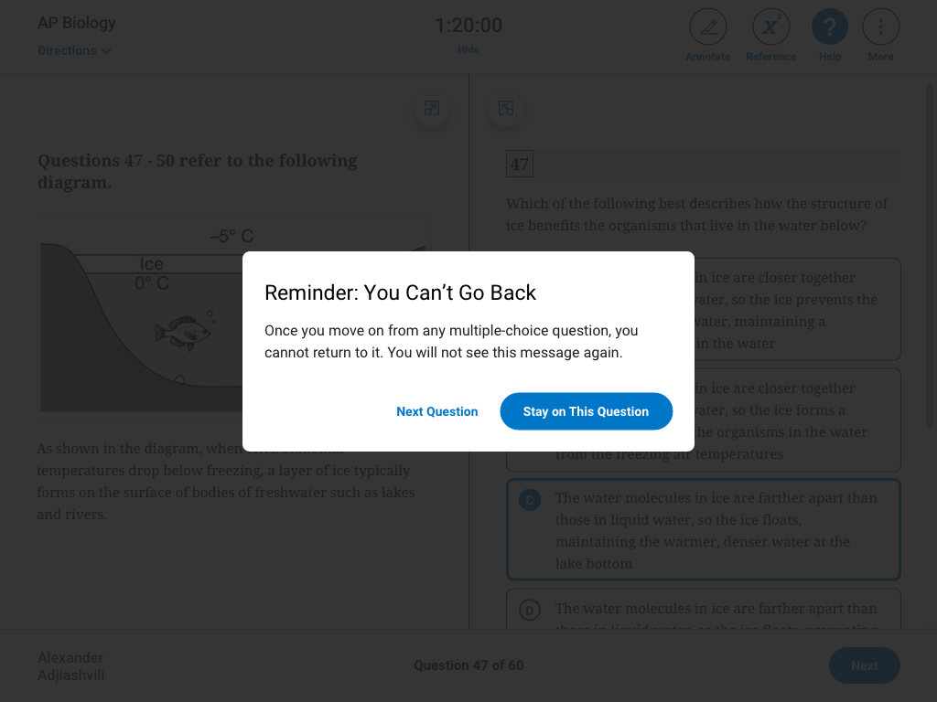
Multiple-Choice Questions: No Going Back
On multiple-choice questions, you won’t be able to move back and forth between questions or return to questions you’ve already answered.
Remember: there’s no penalty for guessing.

Slide 16
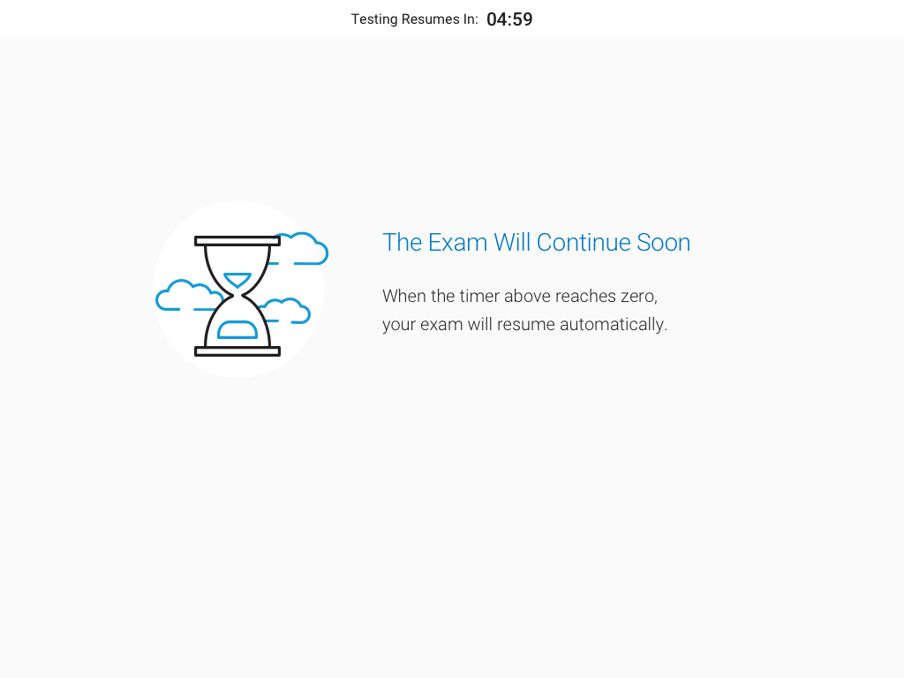
Breaks Between Sections
Between sections, you’ll have a break. A timer will let you know when the next section starts.
Just like at the beginning of the exam, when the time expires, the exam will resume automatically.

Slide 17
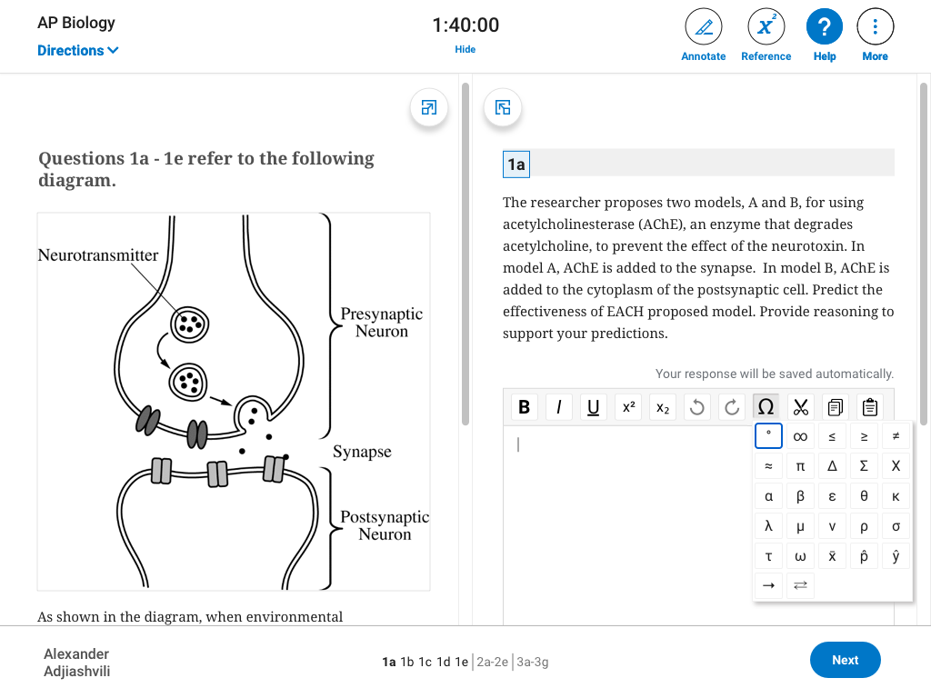
Free-Response Questions
On free-response questions, you’ll type directly into the app, and all your work will be saved automatically. Any special characters you need are available in the text editor.
There are no files to upload, and you won’t submit any handwritten work.

Slide 18
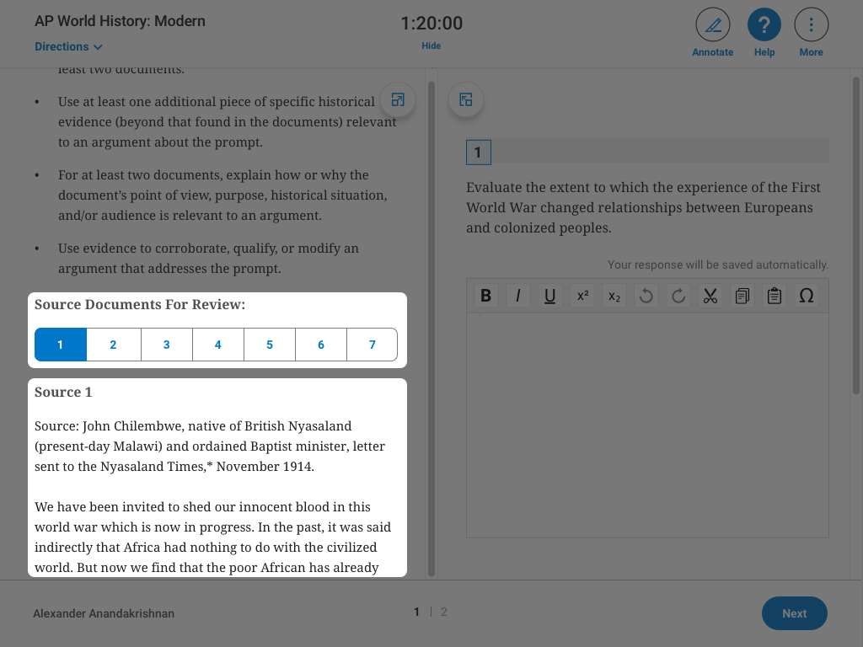
Source Documents
Students taking one of these exams (English Language, European History, US History, World History, or Seminar) will have free-response questions that include multiple sources or documents within the app.
On longer questions, you may need to scroll down on the left side of the screen. Make sure you open each source or document.

Slide 19
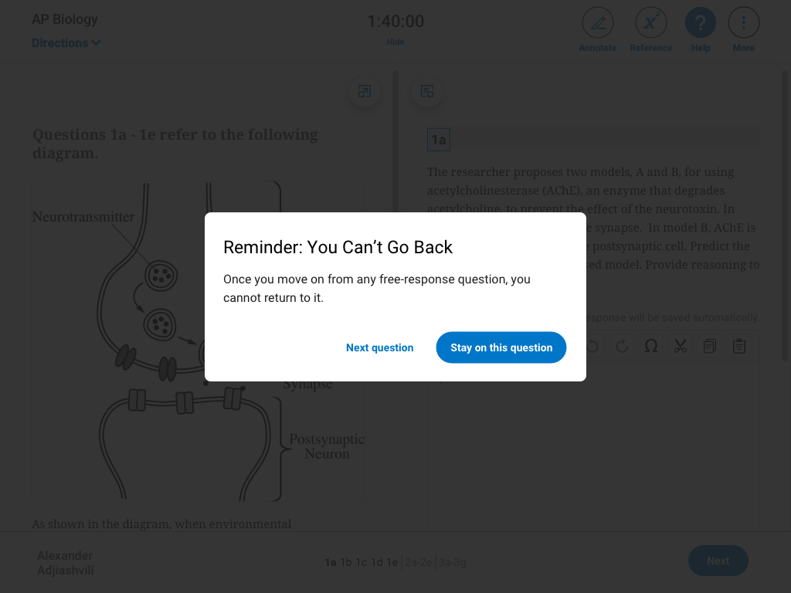
Free-Response Questions: No Going Back
Once you move on from any free-response question, you cannot go back to it.
But on free-response questions that have more than 1 part, you can go back and forth between parts until you’re done working on the entire question.

Slide 20
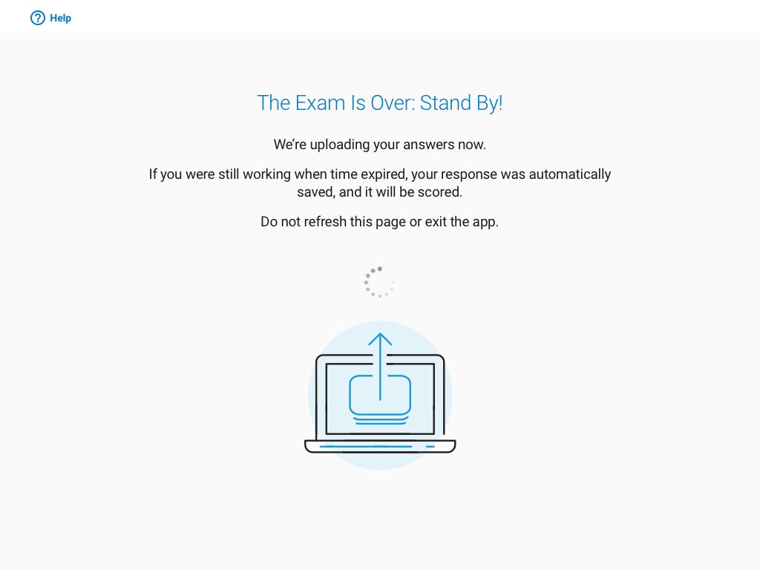
After Your Exam: Answer Submission
When testing time expires, the app will end the exam and your completed answers will be submitted automatically.
Do not exit the app until you see a “congratulations” message, confirming that we received your answers.

Slide 21
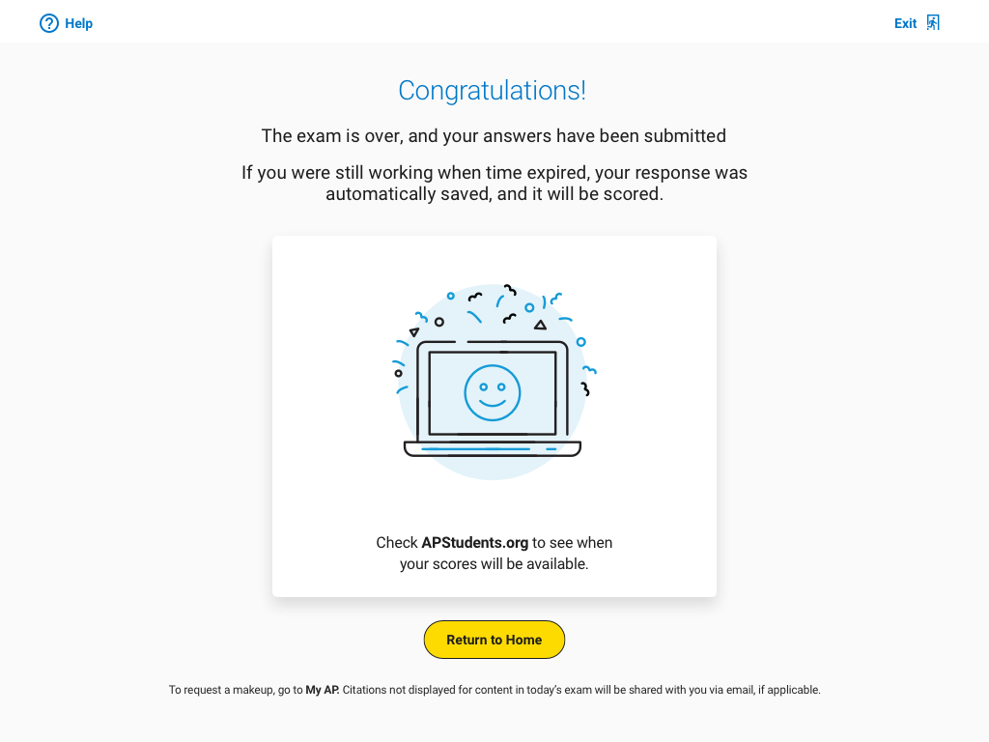
After Your Exam: Answer Submission Complete
When you see this screen, you’re all set!
Check AP Students to see when your results will be posted.

Slide 22
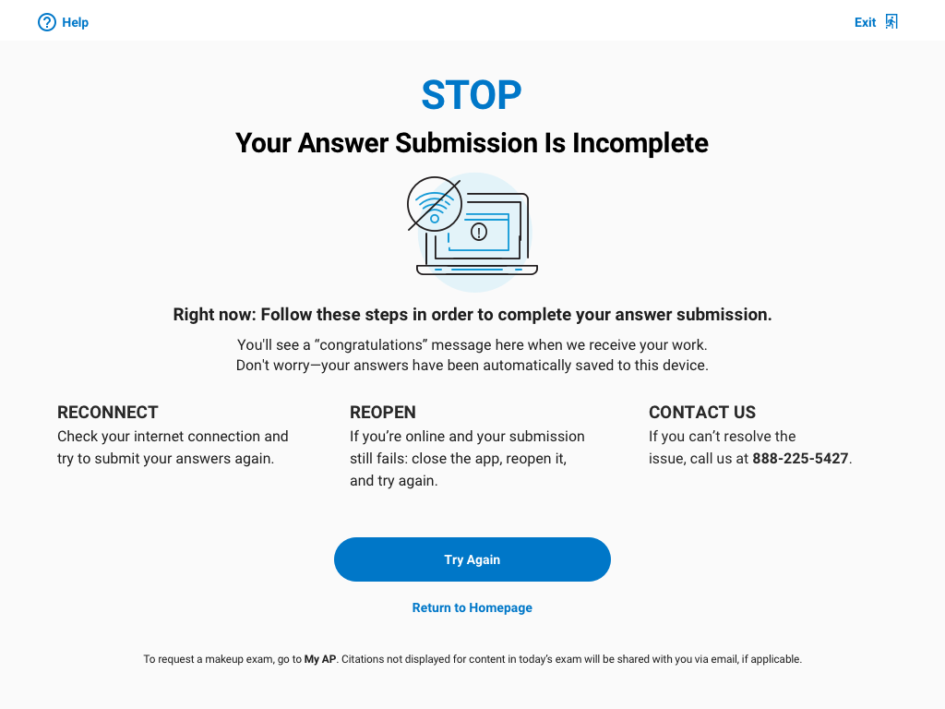
After Your Exam: Answer Submission Incomplete
If your internet connection drops at the end of the test, we’ll show you some immediate steps that you’ll take to complete your answer submission.
If you run into an issue you can’t recover from, you can go to My AP to request a makeup.

Slide 23
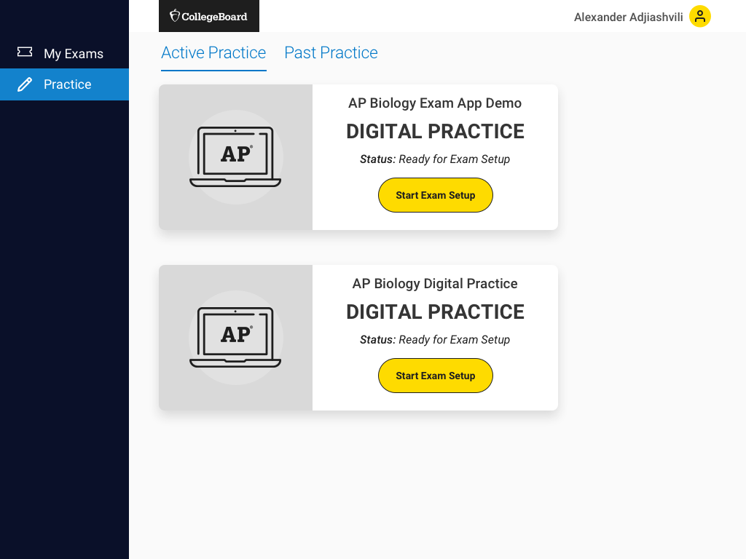
Next Steps
In early April, AP students will be able to download the app and start practicing.
You’ll need your College Board username and password to use the exam app, so make sure you have that info handy.
Good luck on your 2021 digital AP Exam!

