Slide 1



Key Takeaways from the AP® Digital
Testing Guide
Preparing for 2021 Digital AP Exams
March 2, 2021

Slide 2


Presentations About This Year’s AP Exams
Highlights for school and district leaders
February 2021:
Presentation that gives an overview of the testing options for 2021 so that school and district leaders have the details needed to make decisions for this year’s AP Exam administration.
cb.org/ap2021examsoverview
Announcement: February 4
Webinar for Administrators: February 11
March 2021:
Presentation that highlights key takeaways from the AP Digital Testing Guide so that school and district leaders can support AP coordinators and technology staff.
cb.org/ap2021digitaltakeaways
Announcement: March 2
Webinar for Administrators: March 4

Slide 3

Preview of the AP Digital Testing Guide
What is the testing guide?
What it is
This downloadable PDF, released March 2, provides schools and districts with information about administering 2021 digital AP Exams. Access the guide at cb.org/ap2021digitalguide.
How to use it
Use the AP Digital Testing Guide in conjunction with the online resources at cb.org/ap2021 to understand how digital AP Exams work.
Purpose of this presentation
This PowerPoint presentation, Key Takeaways from the AP Digital Testing Guide, is designed to introduce the AP Digital Testing Guide, but it's not intended to serve as a replacement for the guide.

Slide 4
WHAT THIS IS NOT
This presentation isn't a replacement for the AP Digital Testing Guide.
Go to the AP Digital Testing Guide
cb.org/ap2021digitalguide

Slide 5
Topics
1
Introduction to the AP Digital Testing Guide
2
Digital Testing: The Basics
3
Actions in AP Registration and Ordering
4
Readiness Steps for Students
5
Digital Testing: The Experience
6
Additional Notes About Digital AP Exams
7
Resources to Help Prepare

Slide 6
Introduction to the AP Digital Testing Guide
1
Cover Page

Slide 7
Information Release Schedule
March 2 and April 8
Initial Release
March 2
With More Details
April 8
Coming Soon!

Slide 8
Topics in the AP Digital Testing Guide
Digital Testing Overview
  Digital Testing Basics
  Exam Security
  Comparing Digital and Paper and Pencil Exams
  Timeline
  Role of the AP Coordinator
  Role of School or District Technology Staff
  Digital Exam Schedule
  Digital Exam Start Times
  Resources to Help Students and Educators Prepare for Digital Exams
  Moving Students to a Later Testing Date
Deadlines to Switch a Student to a Later Exam Administration
How to Switch a Student to a Later Exam Administration
Indicate Reason for Changing Exam Date
Confirming Accommodations for Digital Exams
Technical Requirements
Testing Devices
Operating Systems
Hardware Considerations
Network Connectivity
Downloading and Installing the Digital Testing App on School-Managed Devices
Preparing for Digital AP Exams
Readiness Steps
Managing Student Readiness and Digital Makeup Requests
College Board Account
Email Address
Exam Day Checklist
Preparing the Home Testing Environment
Taking Digital AP Exams
Step 1: Download and Install the Digital Testing
Application
Step 2: Practice with Sample Questions in the Digital Testing Application
Step 3: Complete Exam Setup
Step 4: Check In to the Exam
Tools and Features
Answering Multiple-Choice Questions
Break Between Sections
Answering Free-Response Questions
Answer Submission
Testing Issues
Administering Digital AP Exams In School
Policies and Procedures
Exam Security
Exam Timing and Synchronous Start Times
Technology Staff
Proctors
Devices
Exam Locations/Exam Rooms
Preparing Students for Digital Exams In School
Exam Day Activities
AP Coordinator Checklist: In School Digital AP Exams
Accommodations for Digital AP Exams
Accommodations Essentials
Moving Students with Accommodations from a Paper Exam to a Digital Exam
Types of Digital Accommodations
Accommodations Details and Testing Considerations
Waiving Accommodations
Temporary Supports
What’s in it?

Slide 9
Digital Testing:
The Basics
2
Cover Page

Slide 10
Digital Testing: Locations and Admin Windows
Schools can mix and match between locations and exam dates, if a digital testing option is available.
In School
At Home
MAY 2021
Sunday | Monday | Tuesday | Wednesday | Thursday | Friday | Saturday
 |  |  |  |  |  | 1
2 | 3 | 4 | 5 | 6 | 7 | 8
9 | 10 | 11 | 12 | 13 | 14 | 15
16 | 17 | 18 | 19 | 20 | 21 | 22
23 | 24 | 25 | 26 | 27 | 28 | 29
30 | 31
JUNE 2021
Sunday | Monday | Tuesday | Wednesday | Thursday | Friday | Saturday
 |  | 1 | 2 | 3 | 4 | 5
6 | 7 | 8 | 9 | 10 | 11 | 12
13 | 14 | 15 | 16 | 17 | 18 | 19
20 | 21 | 22 | 23 | 24 | 25 | 26
27 | 28 | 29 | 30
ADMIN 3 Digital Exams
ADMIN 3 Digital Exams
ADMIN 2 Digital Exams
ADMIN 2 Digital Exams
NOTE: Digital exams, offered either in school or at home, are available for 17 AP courses during Administration 2 and for 25 AP courses during Administration 3.

Slide 11
Digital Testing: Overview
Reminders about digital testing
Length, Schedule, and Locations | Technology and Access | Registration and Readiness
Length: Digital AP Exams are full-length exams that test the same knowledge and skills as paper and pencil exams; most have multiple-choice and free-response sections. Exam Dates: Digital exams are available for specific AP subjects in Administration 2 and 3 and the digital format is the only exam format available for those subjects on those dates. Start Times: Exams have synchronous start times, worldwide at 12 p.m. or 4 p.m. Eastern Daylight Time (EDT). For exams with 2 sections, the second section starts automatically, after the scheduled break. Testing Locations: Exams can be administered in schools or off-site testing locations; the AP coordinator can also authorize the exams to be taken at home. | Devices: Exams are taken on desktop and laptop computers (Mac, Windows, school-managed Chromebooks) and may not be taken on smartphones; the computer must have a power cord. Internet: An internet connection is required, but students will be able to continue testing even if their connection drops momentarily. Accommodations: Digital AP Exams will be accessible to students with disabilities who have received approval for testing accommodations by the College Board Services for Students with Disabilities office. Students will not need to reapply for accommodations to take digital AP Exams. Sign-in: Students will need to use their College Board username/password to access digital exams. | Registration: No student can take a digital AP Exam unless their AP coordinator has assigned them to that exam in AP Registration and Ordering. Readiness Steps: Students need to complete a few steps before exam day to confirm that their testing computer is ready for the exam; beginning in April, educators will have access to a dashboard that helps them track students’ progress preparing for and completing digital AP Exams. Practice: Beginning April 8, students and educators will be able to access the digital testing application and practice with each type of multiple-choice and free-response question students will see on exam day. Digital exam practice will also confirm students’ technology and let students practice using the tools and features in the digital testing application.
For instructions, see the
AP Digital Testing Guide.

Slide 12
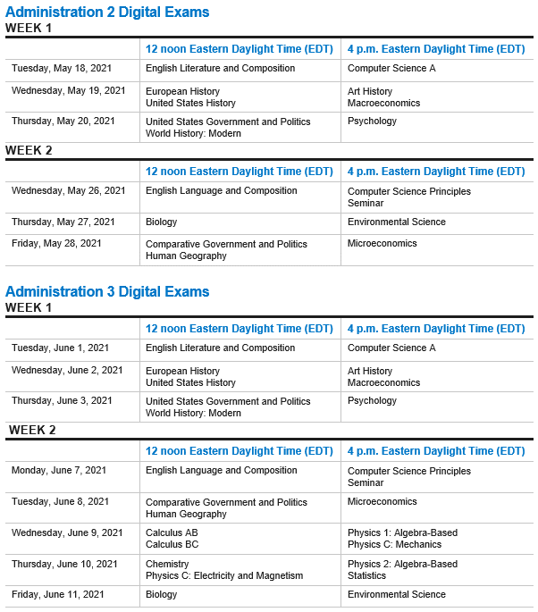
Digital Testing: Schedule and Start Times
Key Terms
Check-in: final pre-exam step students must complete on exam day, 30 minutes before their scheduled exam.
Start time: the moment students taking a given exam can begin seeing and answering questions.
Key Details
Digital AP Exams have synchronous start times worldwide and automatically begin at 12 p.m. EDT and 4 p.m. EDT.
The time each exam resumes after the scheduled break is also synchronous.
The start time for digital AP Exams is controlled by the digital testing application and can’t be adjusted by students or school staff.
When administering digital AP Exams in school, students must be seated and ready to test at the exam start time and start of the second section of the exam or they'll lose time on their exam.
All students are required to check in to their digital exam 30 minutes before the official start time to complete final pre-exam steps.
For instructions, see the
AP Digital Testing Guide.

Slide 13
Digital Testing: Device Requirements
What’s allowed
Allowed* |  | School-Managed | Personal, Student-Managed
Desktop or laptop computer
Windows PC
Mac
School-managed Chromebook
* Provided the device meets the technical requirements outlined in the AP Digital Testing Guide.
For instructions, see the
AP Digital Testing Guide.

Slide 14
Digital Testing: Technical Requirements
Summary
 | PC | Mac | Chromebook
Operating System* | Windows 8.0/8.1/10 | OS X 10.11–10.15 & 11.0+ | Chrome OS v83+
Processor* RAM* Disk Space* | 1 GHZ 2 GB RAM (64-bit) 200 MB free | 1 GHZ 2 GB RAM (64-bit) 200 MB free | 100 MB free
Screen size and resolution* | 10” diagonal, 1024 x 768 pixels
Device management | Managed or unmanaged | Managed or unmanaged | Google Workspace managed
Keyboard/mouse | Internal or external (wired or Bluetooth)
Battery and Power | Fully charged to last through a full-length exam, plugged to power source if needed
Network* | Reliable internet access (wired or Wi-Fi), at least 3 Mbps for each student Inbound/ outbound traffic to/from collegeboard.org
For in-school testing: Check the AP Digital Testing Guide for details on Wireless Access Points and Ports and Protocols.
* minimum requirements
NOTE: This is current as of 2/28/2021
For instructions, see the
AP Digital Testing Guide.

Slide 15
Digital Testing: Security
Reminders about digital testing
Security Features
Digital exams administered at home or in school school will: Not allow students to return to answered questions or move back-and-forth between unanswered questions. Begin at the same time worldwide with synchronous section start times. Include security features to prevent students from collaborating, accessing unauthorized aids, or attempting to have someone else test for them. Textbooks and notes aren't permitted for digital exams administered in school. We understand students taking digital exams at home may have access to these materials. To prevent students from gaining an unfair advantage, digital exams will: Not include questions that can be answered with internet searches, textbooks, notes, study guides, or similar material. Be reviewed with plagiarism detection software. Be reviewed with post-exam analyses to identify collaboration or use of unauthorized aids.
NOTE: Exam violations on any AP Exam—paper or digital—will result in a score cancellation and additional consequences as warranted.
For instructions, see the
AP Digital Testing Guide.

Slide 16
Digital Testing: Timeline
Overview of steps to administration
March | April | May | June
Continue to plan this year’s AP Exam administration. | APRIL 1. Indicate orders for paper and pencil AP Exams or AP Chinese and Japanese Exams for Administrations 1, 2, or 3. | Deadlines to move students to Administration 2 or 3 digital exams are 7 calendar days before the scheduled exam date. | Deadlines to move students to Administration 3 digital exams are 7 calendar days before the scheduled exam date.
Begin assigning students to digital exams in Administration 2 or 3, if needed. | APRIL 8: Digital testing application available. Install digital testing application on school-managed devices. | Students continue to download and install the digital testing application. | Students continue to download and install the digital testing application.
MARCH 12: Set “Order Status” to “Yes” for all students who intend to test. | APRIL 8: Students download and install the digital testing application on their testing computer. | Students continue to access digital practice after the digital testing application is installed. | Students continue to access digital practice after the digital testing application is installed.
 | APRIL 8: Students access digital practice after the digital testing application is installed. | Students complete digital exam setup for each of their Administration 2 or 3 exams. | Students complete digital exam setup for each of their Administration 3 exams.
 | APRIL 8: Configuration instructions available for students testing with assistive technology. | MAY 18–20, 26–28. Administration 2 digital exams. Students must check in to their exams 30 minutes before the official start time. | JUNE 1–3, 7–11. Administration 3 digital exams. Students must check in to their exams 30 minutes before the official start time.
 | Move students to Administration 2 and 3 digital exams, if needed.

Slide 17
Actions in
AP Registration and Ordering
3
Cover Page

Slide 18
Ordering Exams, Moving Students
Actions in AP Registration and Ordering
By March 12. Set “Order Status” to “Yes” for all students who intend to test.
By April 1. Indicate orders for paper and pencil AP Exams or AP Chinese and Japanese Exams for any exam administration (Administration 1, 2, or 3).
After April 1. Authorize students for digital exams for Administration 2 or 3, if needed, until 11:59 p.m. EDT 7 calendar days before the scheduled exam date.
Before taking any action in APRO to change students’ exam dates, it’s important that AP coordinators work with students, teachers, and administrators to determine how the school expects to administer exams this year. The following resources may help:
  2021 AP Exam Planning Guide available at cb.org/ap2021planningguide
  2021 AP Exam Schedule at cb.org/apexamdates
For instructions, see the
AP Digital Testing Guide.

Slide 19
Deadlines for Moving Students
Paper Makeup Deadlines:
If something unexpected occurs that requires a school to move students to a different paper and pencil exam date—such as an illness, incident, or unforeseen school closure—then schools may switch an existing exam order to a different available paper and pencil date by these deadlines:
*Paper Exam Administration 2:
May 7 (outside U.S.); May 14 (U.S.)
**Paper Exam:
Administration 3:
May 26 (all locations)
An exam can only be moved to a date for which the exam is available.
From: | To: | Deadline to submit the change in APRO:
Paper Exam: Administration 1 | Paper Exam: Administration 2 | April 1 (all locations)*
 | Paper Exam: Administration 3 | April 1 (all locations)**
 | Digital Exam: Administration 2 | By 11:59 p.m. EDT 7 calendar days before the scheduled digital exam date
 | Digital Exam: Administration 3 | By 11:59 p.m. EDT 7 calendar days before the scheduled digital exam date
Paper Exam: Administration 2 | Paper Exam: Administration 1 | April 1 (all locations)
 | Paper Exam: Administration 3 | April 1 (all locations)**
 | Digital Exam: Administration 3 | By 11:59 p.m. EDT 7 calendar days before the scheduled digital exam date
Paper Exam: Administration 3 | Paper Exam: Administration 1 | April 1 (all locations)
 | Paper Exam: Administration 2 | April 1 (all locations)*
Digital Exam: Administration 2 | Paper Exam: Administration 1 | April 1 (all locations)
 | Digital Exam: Administration 3 | By 11:59 p.m. EDT 7 calendar days before the scheduled digital exam date
Digital Exam: Administration 3 | Paper Exam: Administration 1 | April 1 (all locations)
 | Paper Exam: Administration 2 | April 1 (all locations)*
 | Digital Exam: Administration 2 | By 11:59 p.m. EDT 7 calendar days before the scheduled digital exam date
Note: All references to paper exams includes Chinese and Japanese exams.
For instructions, see the
AP Digital Testing Guide.

Slide 20
Scenario A
An example for moving students from paper to digital
SCENARIO A
An AP coordinator needs to switch a student from the paper and pencil exam for AP Art History during Administration 1 to the digital exam for AP Art History during Administration 2, which is scheduled for May 19 at 4 p.m. EDT.
What's the deadline for the AP coordinator to make this switch and assign the student to Administration 2 for AP Art History?
SOLUTION
The deadline for the AP coordinator to assign the student to AP Art History for Administration 2 is May 12 at 11:59 p.m. EDT because that's 7 calendar days before the scheduled digital exam date.
For instructions, see the
AP Digital Testing Guide.

Slide 21
Scenario B
An example for moving students from paper to paper
SCENARIO B
An AP coordinator at a school in the United States needs to switch a student from the paper and pencil exam for AP Calculus AB during Administration 1 to the paper and pencil exam for AP Calculus AB during Administration 2. During Administration 2, AP Calculus AB exam is scheduled for May 24 at 8 a.m. local time.
What's the deadline for the AP coordinator to make this switch and assign the student to Administration 2 for AP Calculus AB for an exam in the United States?
SOLUTION
The deadline for the AP coordinator to assign the student to AP Calculus AB for Administration 2 is April 1 because that's the deadline to assign a student to paper and pencil exams or Chinese and Japanese exams for any administration.
Paper Makeup Deadline:
If something unexpected occurs that requires a school to move students to a different paper and pencil exam date—such as an illness, incident, or unforeseen school closure—then schools may switch an existing exam order to a different available paper and pencil date in AP Registration and Ordering by May 7 (outside U.S.) and May 14 (U.S.) for Administration 2 and May 26 (all locations) for Administration 3.
For instructions, see the
AP Digital Testing Guide.

Slide 22
Scenario C
An example for moving students from later exam date to an earlier exam date
SCENARIO C
An AP coordinator at a school in the United States needs to switch a student from the digital exam for AP English Literature and Composition during Administration 2 to the paper and pencil exam for AP English Literature and Composition during Administration 1. During Administration 1, the AP English Literature and Composition Exam is scheduled for May 5 at 8 a.m. local time.
What's the deadline for the AP coordinator to make this switch and assign the student to Administration 1 for AP English Literature and Composition for an exam in the United States?
SOLUTION
The deadline for the AP coordinator to assign the student to AP English Literature and Composition for Administration 1 is April 1 because that's the deadline to indicate a student’s intent to take paper and pencil exams or Chinese and Japanese exams for any administration.
Paper and pencil exams in Administration 1 cannot be ordered after April 1.
For instructions, see the
AP Digital Testing Guide.

Slide 23
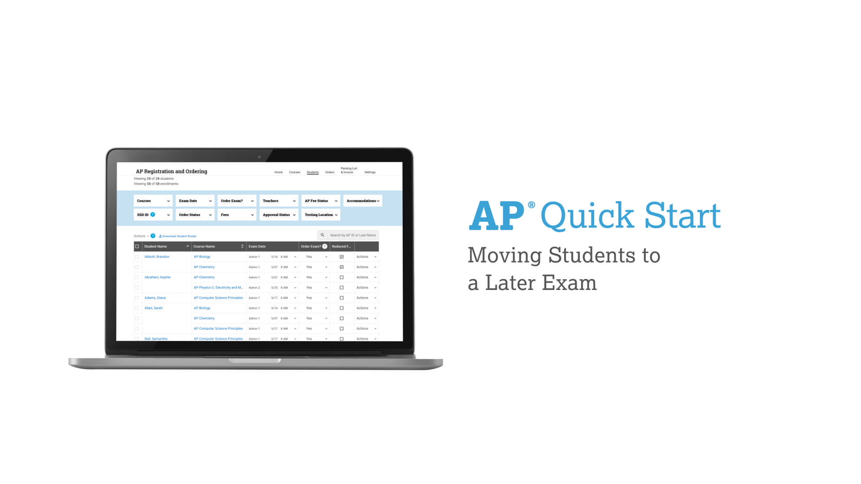
Here’s What That Looks Like
How to move students to later exam dates in AP Registration and Ordering
Watch the AP Quick Start
youtu.be/6n2FAkdLfrg
Watch the AP Quick Start video to see how AP coordinators can:
Move a student from Administration 1 to Administration 2.
Move one full section of an AP course from Administration 1 to Administration 2.
Move an entire AP course (all students and sections) from Administration 1 to Administration 2.
Manage testing accommodations when moving a student with approved accommodations from a paper and pencil exam to a digital exam.
For instructions, see the
AP Digital Testing Guide.

Slide 24

Changing a Student’s Exam Date
Actions in AP Registration and Ordering
Switch a Student’s Exam Date in APRO | Indicate Reasons for Changing Exam Date | Confirm Accommodations for Digital Exams (if applicable)
To switch a student’s exam date: Find the Student in APRO: Go to the student roster in APRO. Select New Exam Date: From the Exam Date column, select the new exam date. Provide Details: After selecting the new exam date, a screen will pop up asking for additional details to finalize the change. Submit Changes: After making changes to any exam dates, go to the Orders page. Submit the changes. | Most reasons for late testing dates don't incur an additional fee. A new reason has been added to address this year’s circumstances: Covid-19: social distancing requirements or lost instruction time | Review Accommodations: When assigning a student to a digital exam in APRO, coordinators will be prompted to review accommodations information. Confirm Accommodations: AP coordinators must confirm the student’s accommodations for digital exams no later than 7 calendar days before the scheduled digital exam date. Note: Special format exam orders will be removed when the student is moved to a digital exam and the order is submitted.
IMPORTANT:
Students must be made aware of the exam type they’re taking and the date, start time, and check-in time (or arrival time).
AP coordinators must submit any unsubmitted changes to their order.
For instructions, see the
AP Digital Testing Guide.

Slide 25
Readiness Steps for Students
4
Cover Page

Slide 26
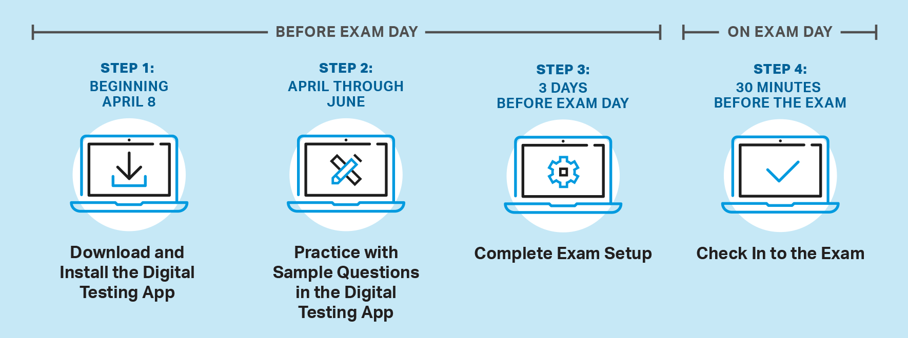
4 Readiness Steps for Students
Taking digital AP Exams

Slide 27
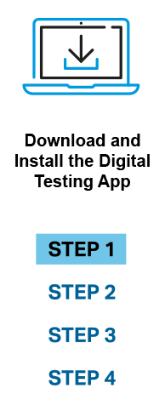
Step 1: Download and Install the Digital Testing Application
Student steps before exam day: Starting April 8
When: Starting April 8, students can download the digital testing application, or the application can be pushed to school- or district-managed devices.
How: Instructions for downloading and installing the digital testing application vary for school-managed devices and student-managed devices.
IMPORTANT:
We recommend all students registered for paper and pencil exams complete this step, in the event they need to take a makeup exam that's only offered digitally.
For instructions, see the
AP Digital Testing Guide.

Slide 28
Step 1: Download and Install the Digital Testing App
Instructions are different for school-managed devices and personal devices.
School-managed
Mac, PC, Chromebook
Personal, Student-managed
Mac, PC
April 8. Additional instructions for downloading the app on
school-managed devices.
April 8. Additional instructions for downloading the app on
personal (non-school-managed) devices.
Students will need:
Their College Board username and password to log in to the digital testing application.
The digital testing application installed on the computer they’ll use for testing before they can access digital practice, exam setup, exam check-in, and the exam itself.
For instructions, see the
AP Digital Testing Guide.

Slide 29
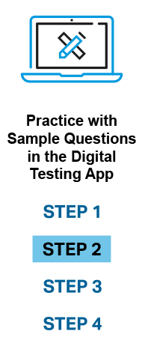
Step 2: Practice with Sample Questions in the Digital Testing Application
Student steps before exam day: Starting April 8
When: After downloading the digital testing application, students can access digital practice for each of their subjects.
How: There are 2 ways students can access digital practice.
  Digital Testing Application
  My AP
Students can:
Answer each type of question they’ll encounter on exam day, and preview exam day flow.
Confirm that technology works as expected before exam day.
Access their responses and the answer key/scoring guidelines.
Retake digital practice.
NOTE: AP coordinators and teachers can view students’ practice status in their respective exam readiness dashboards and can confirm that students’ technology works as expected.
For instructions, see the
AP Digital Testing Guide.

Slide 30
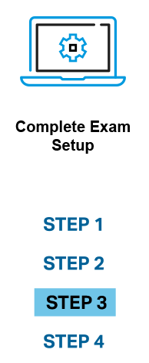
Step 3: Complete Exam Setup
Student steps before exam day: Starting April 8
When: Exam setup opens 3 calendar days before each digital exam, and students must complete setup no later than the day before the exam—for each digital exam they take.
How: Students can access exam setup by launching the digital testing application.
IMPORTANT:
A student must complete exam setup for each digital exam they take, on the same computer they'll use for testing.
Once a student has completed exam setup on a testing computer, the computer can’t be shared with another student.
For instructions, see the
AP Digital Testing Guide.

Slide 31
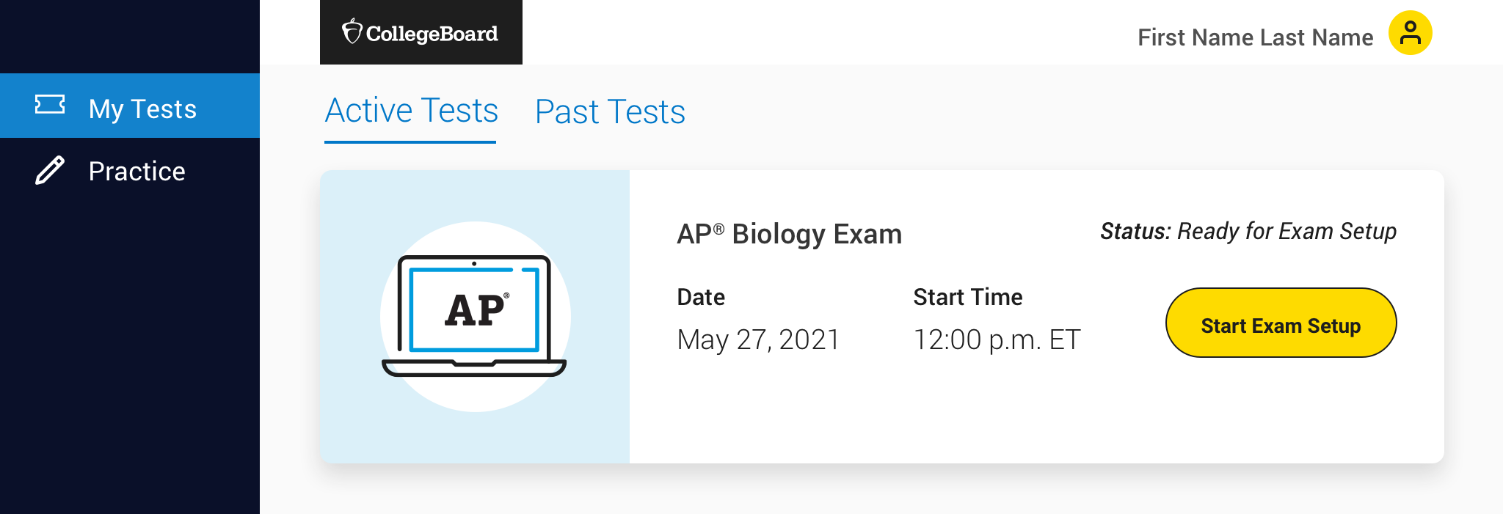
Step 3: Complete Exam Setup
Access exam setup from the Digital Testing App
Students can access exam setup by launching the digital testing app and signing in with their College Board username and password.
They should find their exam on My Tests and click the Start Exam Setup button.
NOTE: Students’ digital exams will not appear until 5 days before the exam date.
Students will be asked to:
  Read and accept Terms and Conditions.
  Confirm personal information.
  Check device requirements.
  Provide permission to reuse answers.
  Review the exam day checklist.
  Watch a quick video.
  Wait for the application to check device settings.
For instructions, see the
AP Digital Testing Guide.

Slide 32
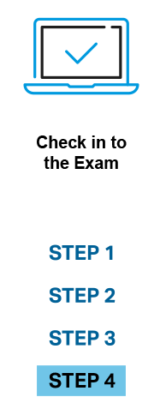
Step 4: Check In to the Exam
Student steps on exam day: 30 Minutes before start time
When: Students will need to check in 30 minutes before their exam’s start time.
  Check in opens at 11:30 a.m. EDT for 12 p.m. EDT exams and 3:30 p.m. EDT for 4 p.m. EDT exams.
How: Students can check in to their exam by launching the digital testing application.
IMPORTANT:
Students should only check in on the device they used to complete exam setup, and they can’t check in on multiple devices.
If a student isn’t able to start the check-in process before the start time of the exam, they won’t be allowed to test and will be asked to request a makeup exam.
For instructions, see the
AP Digital Testing Guide.

Slide 33

Step 4: Check In to the Exam
Access exam check-in from the Digital Testing App.
Students will be asked to:
Type a digital test security statement.
Review the test day checklist.
Enter secure mode.
Wait until the exam begins, paying attention to the timer that counts down to exam start time.
For instructions, see the
AP Digital Testing Guide.

Slide 34
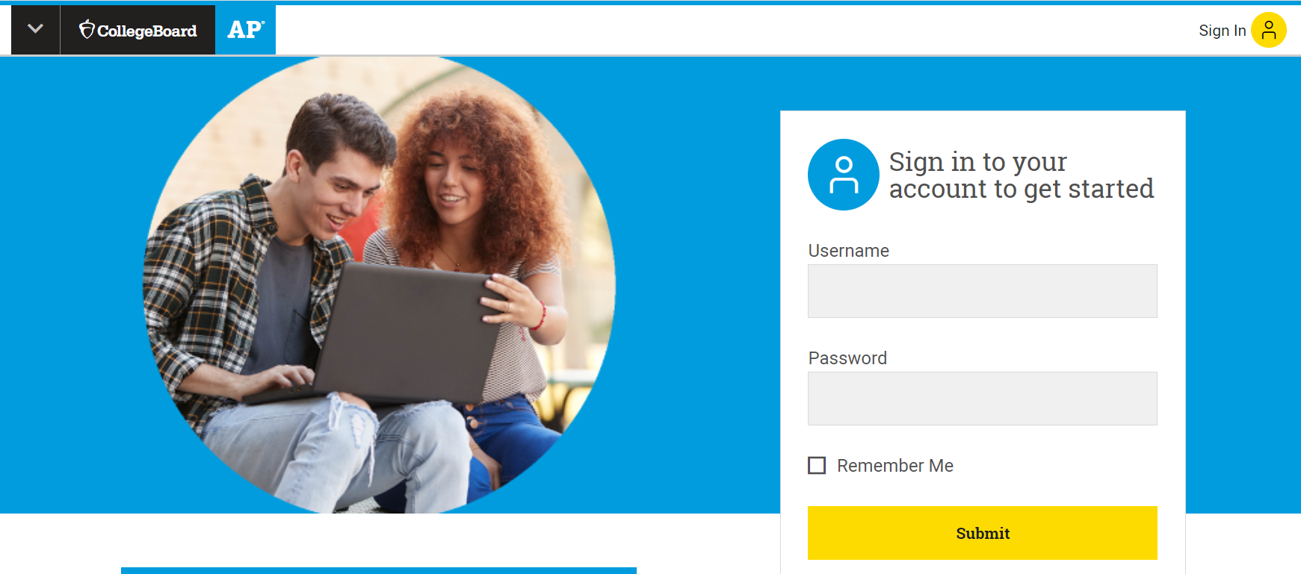
Student Login and Contact Information
myap.collegeboard.org
Students will need a College Board account to access the digital AP Exams they’ve been authorized to take by the AP coordinator.
Schools should: ensure that students know their College Board account information.
Students should: log in to their College Board account and check that their personal information and email address is accurate, editing if needed.
For instructions, see the
AP Digital Testing Guide.

Slide 35
Monitoring Student Readiness
Taking digital AP Exams
Starting in mid-April, a new Digital Exam Readiness Dashboard will be available
for AP coordinators and AP teachers.
 | AP coordinators | AP teachers
Track student readiness for digital exams by showing status of installation, setup, check-in, and exam progress
Manage student makeup requests for digital exams
For instructions, see the
AP Digital Testing Guide.

Slide 36
Digital Testing:
The Experience
5
Cover Page

Slide 37

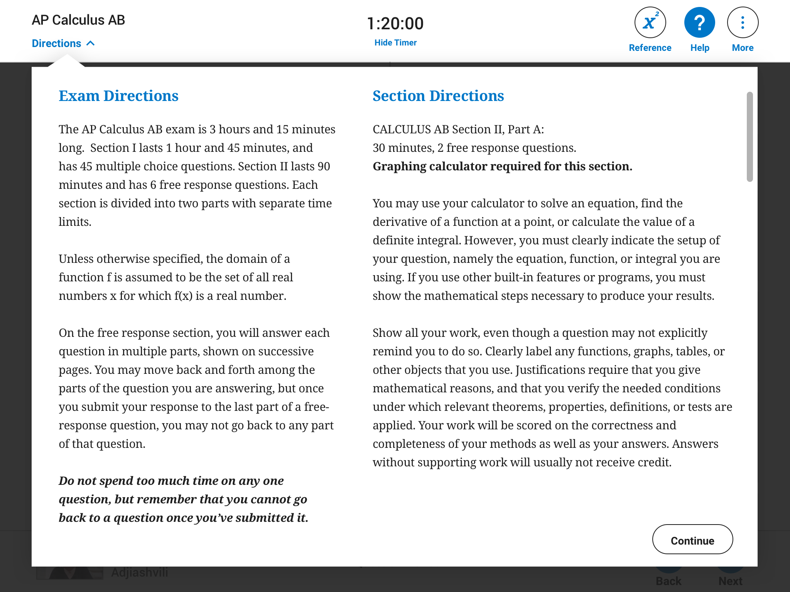
Tools and Features
Support for students as they test
Tools/Features Include:
Directions
A timer
Reference materials
Help menu
Zoom in and out
Expand Right and Expand Left arrows
And more
  Students can practice with all tools and features beginning April 8.
  If the app crashes or the student exits for any reason, they can relaunch the app. However, the timer will continue counting down.
Details
For instructions, see the
AP Digital Testing Guide.

Slide 38
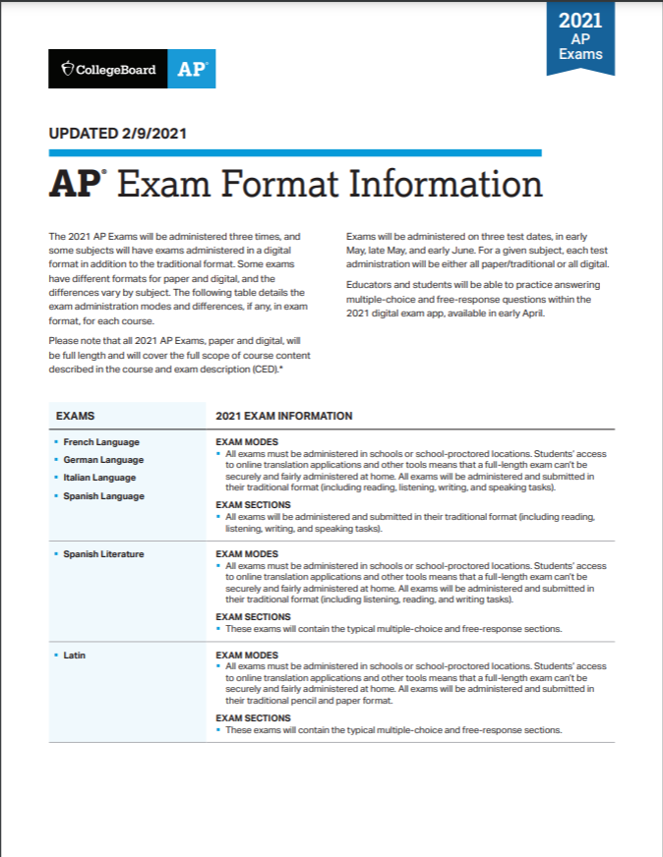
Important Features of Digital AP Exams
Section I
Break
Section II
Full-length. As with paper and pencil exams, digital exams are full-length exams with a Section I and Section II, split by a break.*
Exam timing. Exam timing is governed by the digital testing application, and timing varies by exam.
Question types. Most exams have 2 main types of questions: multiple-choice questions and free-response questions.
Students can’t go back. If students skip ahead, they won’t be able to go back. This is one of many security features.
*The AP Computer Science Principles and AP Seminar exams have only one section.
cb.org/ap2021examformat
For instructions, see the
AP Digital Testing Guide.

Slide 39
Answering Questions on Digital AP Exams
The digital exam experience
Multiple-Choice Section:
The digital testing application will remind students they can’t go back whenever they:
  Attempt to move on from their first multiple-choice question.
  Attempt to leave a multiple-choice question they haven’t answered.
Free-Response Section:
The digital testing application will remind students they can’t
go back whenever they:
  Attempt to leave a free-response question.
Multi-part free-response questions: On free-response questions that have multiple parts that are answered on separate screens, students will be able to go back and forth between parts of the question they’re answering. Once they answer the last part of the question and go on to the next one, they cannot go back to any part of the last question.
Students can’t go back.
If students skip ahead, they won’t be able to go back.
*The AP Computer Science Principles and AP Seminar exams have only one section.
For instructions, see the
AP Digital Testing Guide.

Slide 40
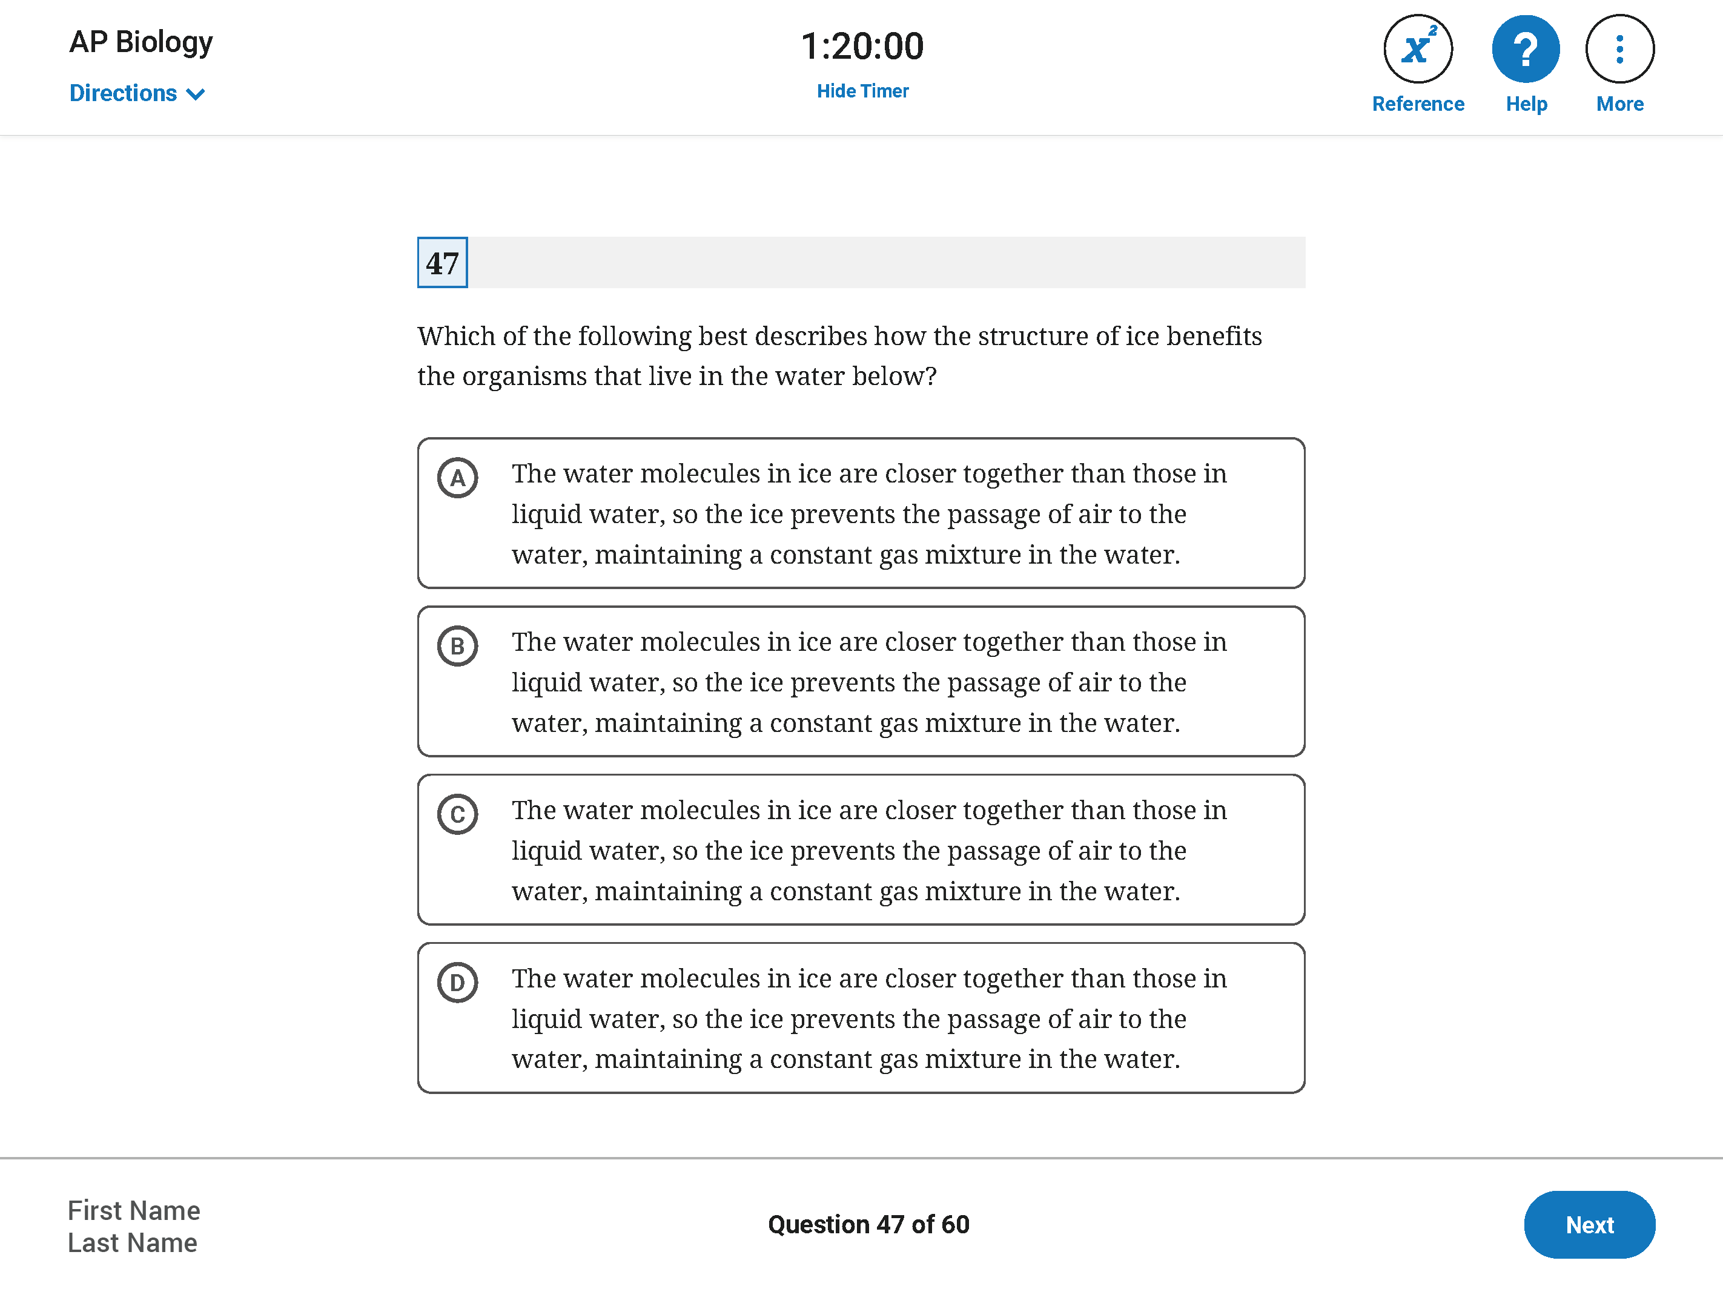
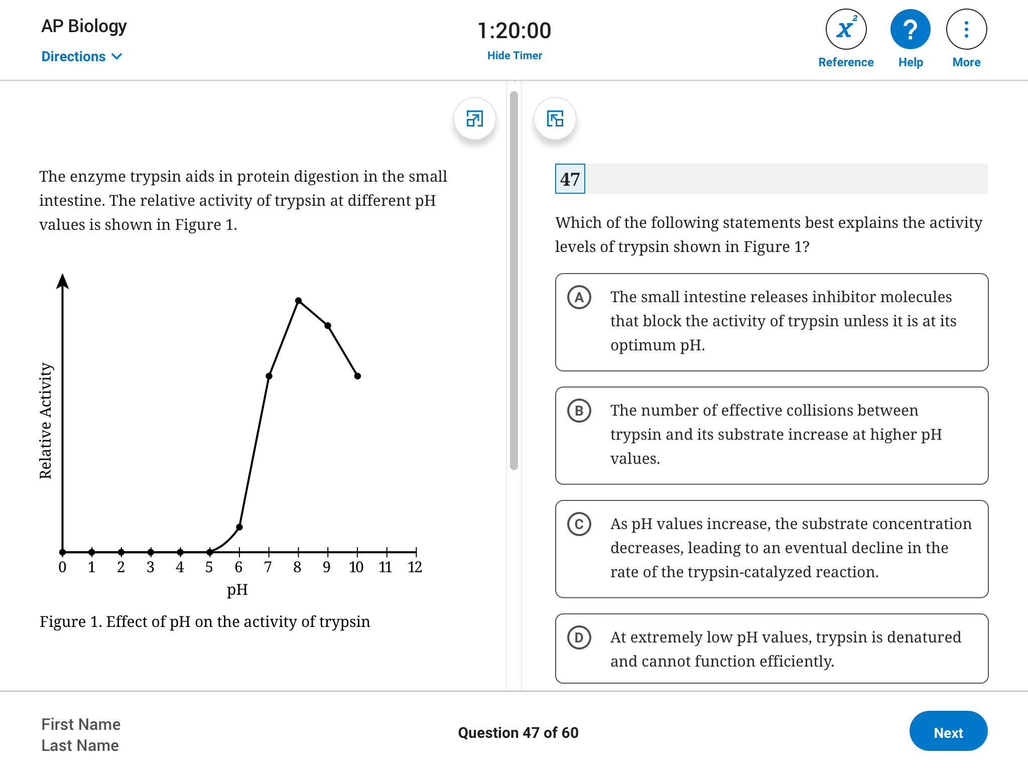
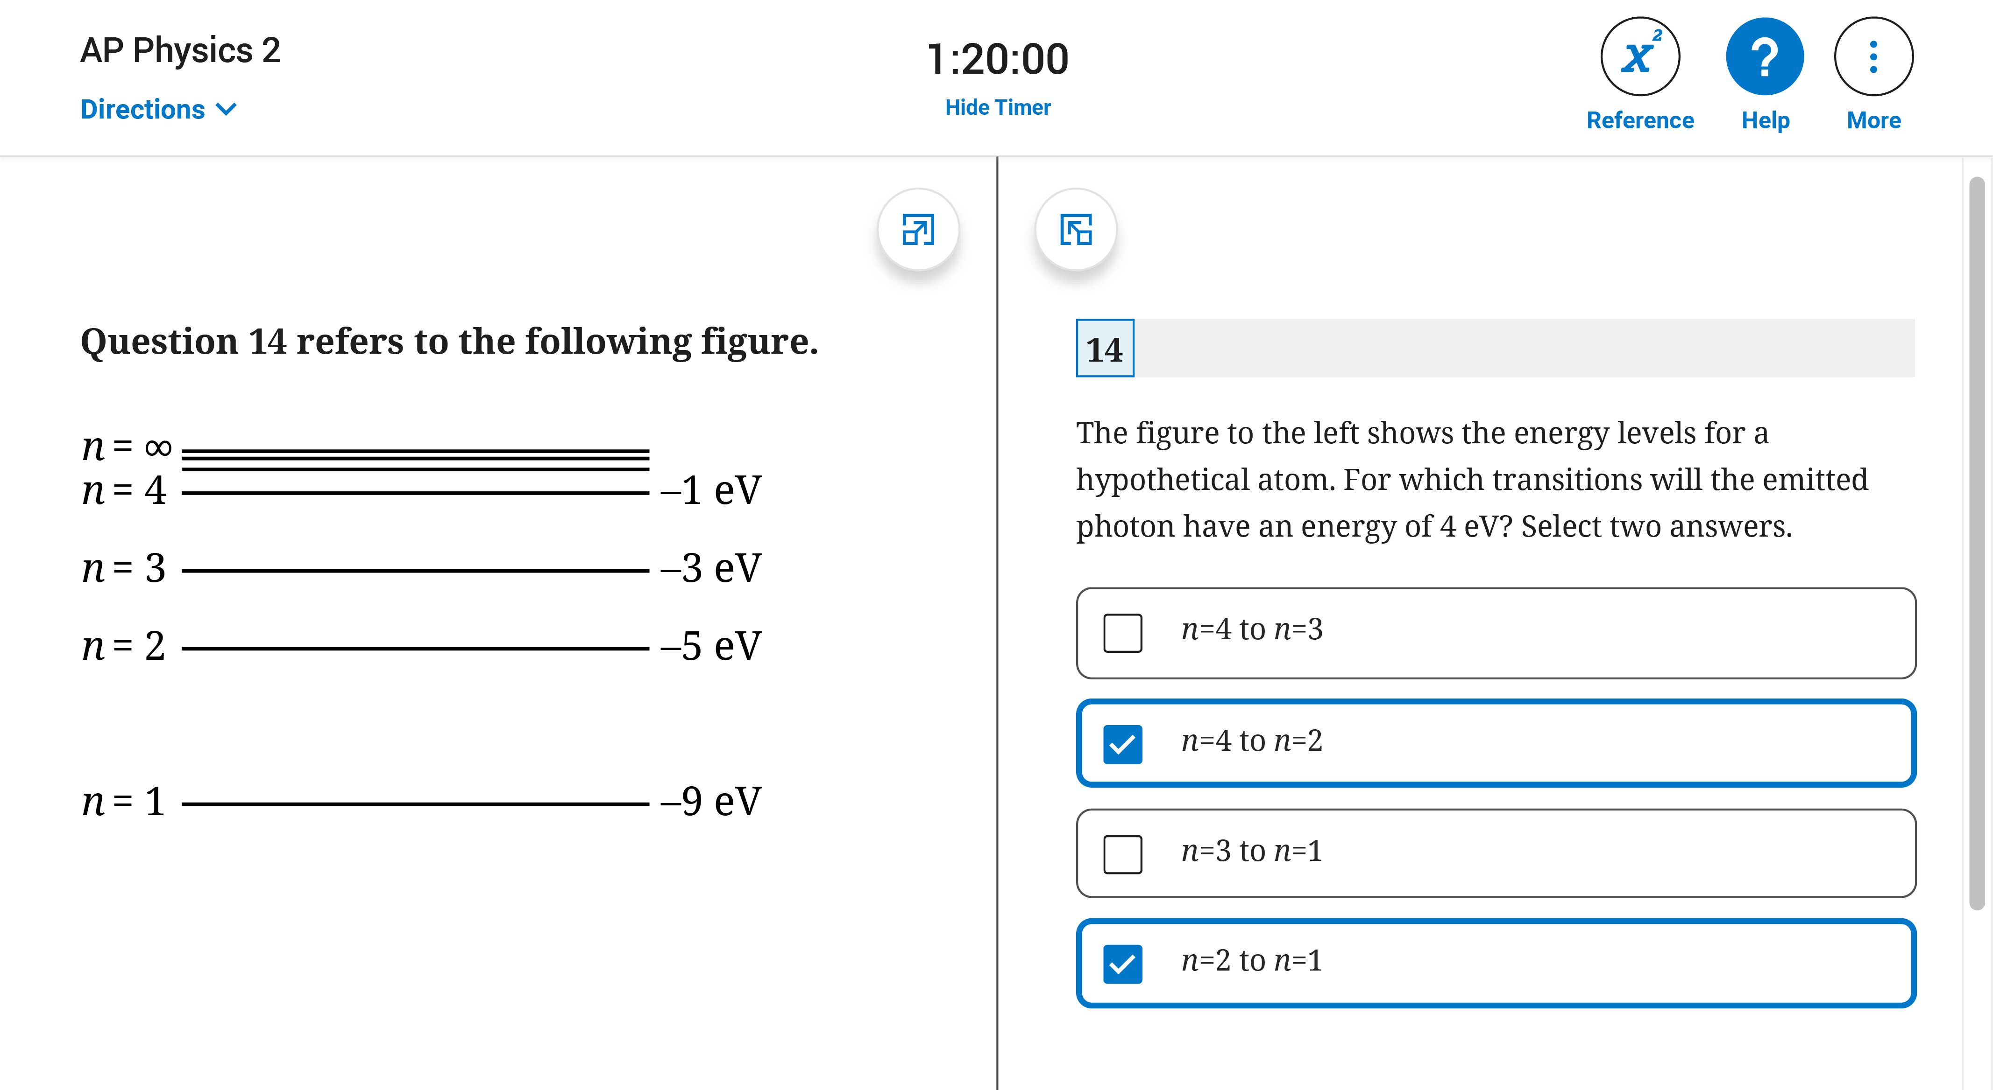
Multiple-Choice Questions
The digital exam experience
Some multiple-choice questions are centered on screen.
Others display stimulus material on the left, and question and answer options on the right. For multiple-choice question sets—more than one question referring to the same stimulus—the stimulus remains on screen for each of the questions in the set.
Just like on the paper and pencil exam, AP Computer Science Principles, AP Physics 1, and AP Physics 2 exams have some questions that require students to select the two correct answer options.
For instructions, see the
AP Digital Testing Guide.

Slide 41

Break Between Sections
The digital exam experience
At the conclusion of Section I, students get a 20-minute break. They’ll see a break screen with a timer counting down the time until the start of the next section.
Students must understand that the exam resumes automatically when the break ends. If a student isn’t seated and ready to test before the end of the break, they may lose time on the exam.
Students must not exit the app or close their laptop screen.
Students may not communicate with their teacher or any other exam taker.
Students should not remove the testing device from the testing room.
In some subjects, Section I and/or Section II are divided into two parts. In those subjects, students will have a one-minute pause between Parts IA and IB or IIA and IIB. As on paper and pencil exams, the pause between parts doesn’t count against the student’s testing time for either part, and students can’t work on their exam during that time.
For instructions, see the
AP Digital Testing Guide.

Slide 42
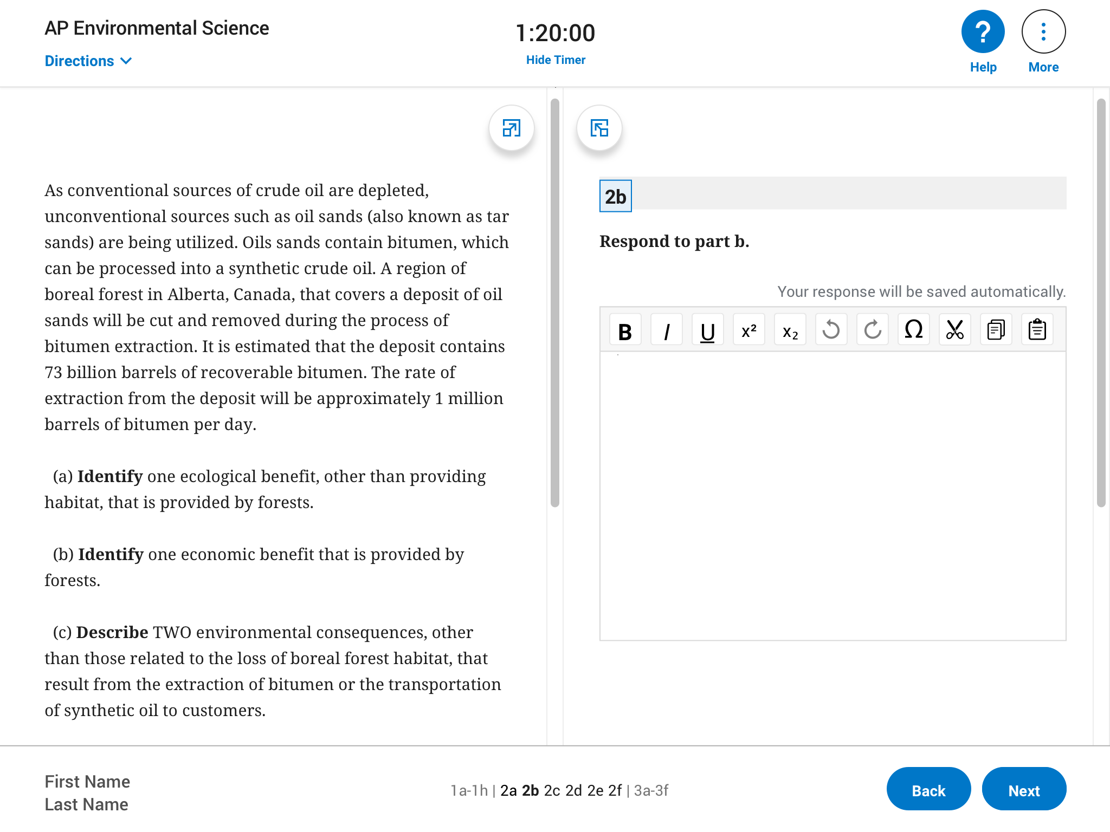
Free-Response Questions
The digital exam experience
Students type responses directly into the application.
Student work is saved to their device automatically while the exam is running.
Students can’t upload any files during testing.
Students can’t submit any handwritten work.
Some free-response questions are centered on screen, with the entire question and text entry box all in one column.
Most free-response questions display stimulus and other question material on the left, and the prompt and text entry box on the right. Some questions are answered in parts over separate screens, and others are answered all on one screen.
Additional Features:
For the questions that have Sources or Documents—Document-Based Questions (DBQs) in the Histories, the Synthesis question in English Language and Composition, and Seminar Part B—a student can select any of the documents to display on the left, while composing their response on the right.
Basic formatting tools will be available: Bold, Italic, Underline; Superscript and Subscript; Undo and Redo; Special Characters; and Cut, Copy, and Paste.
For instructions, see the
AP Digital Testing Guide.

Slide 43
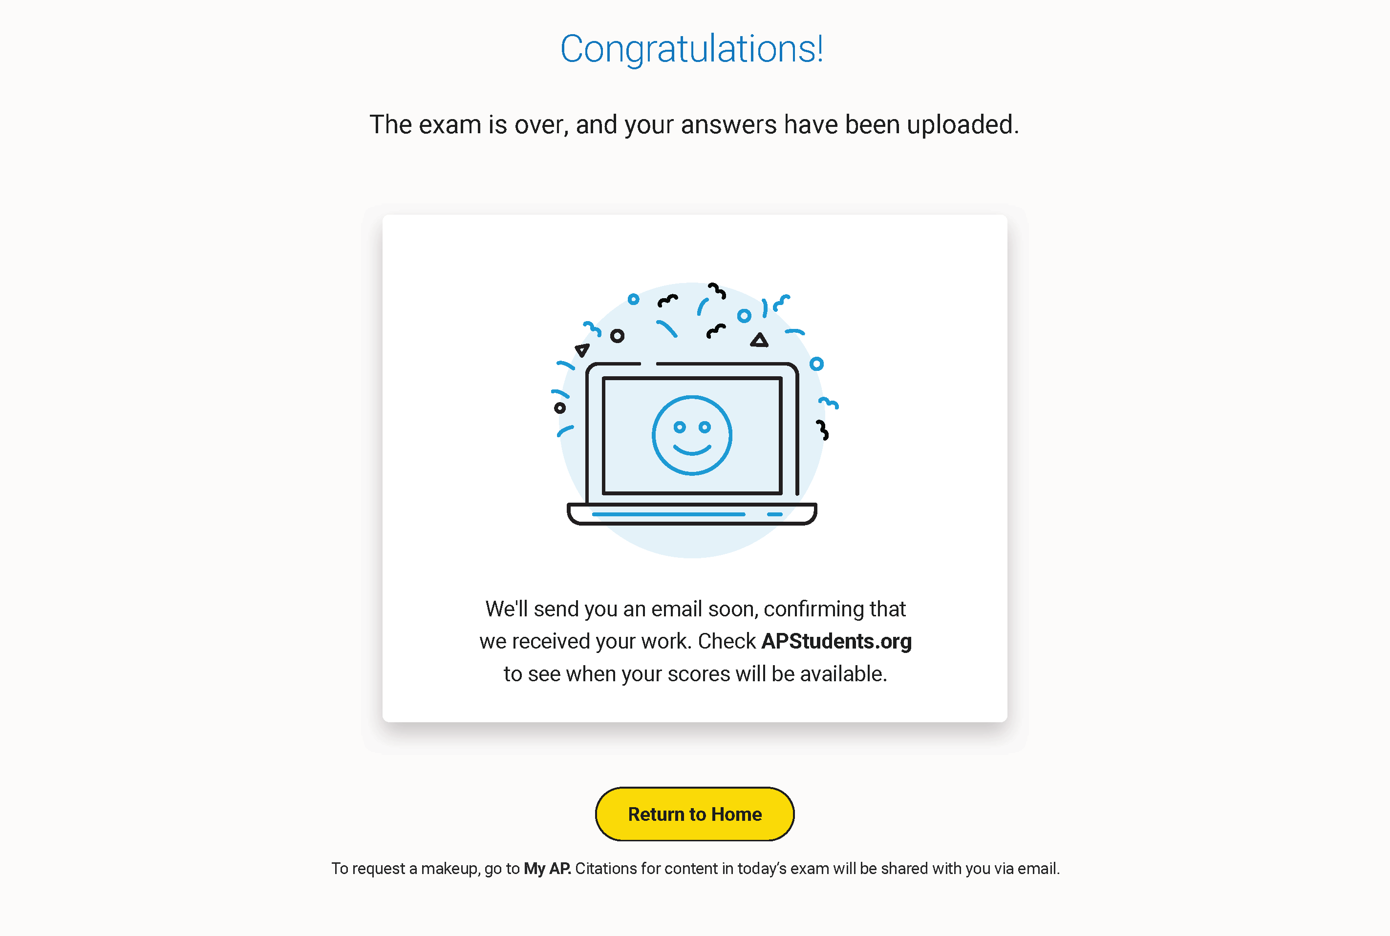
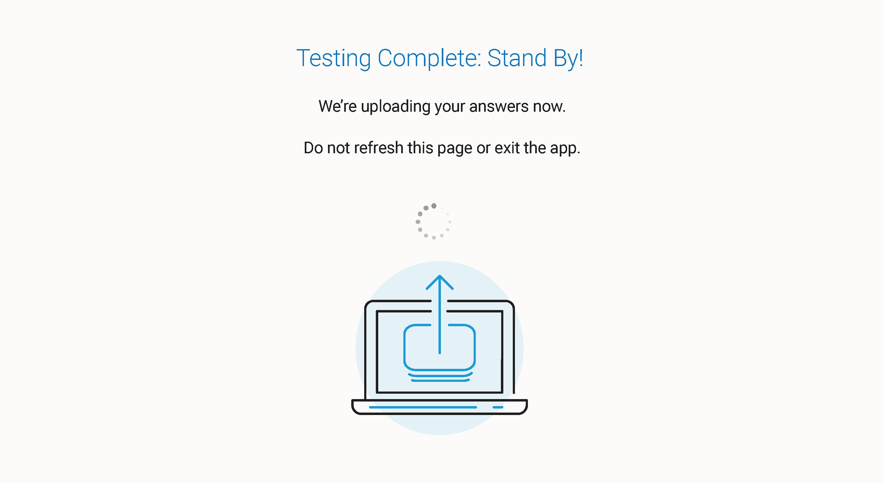
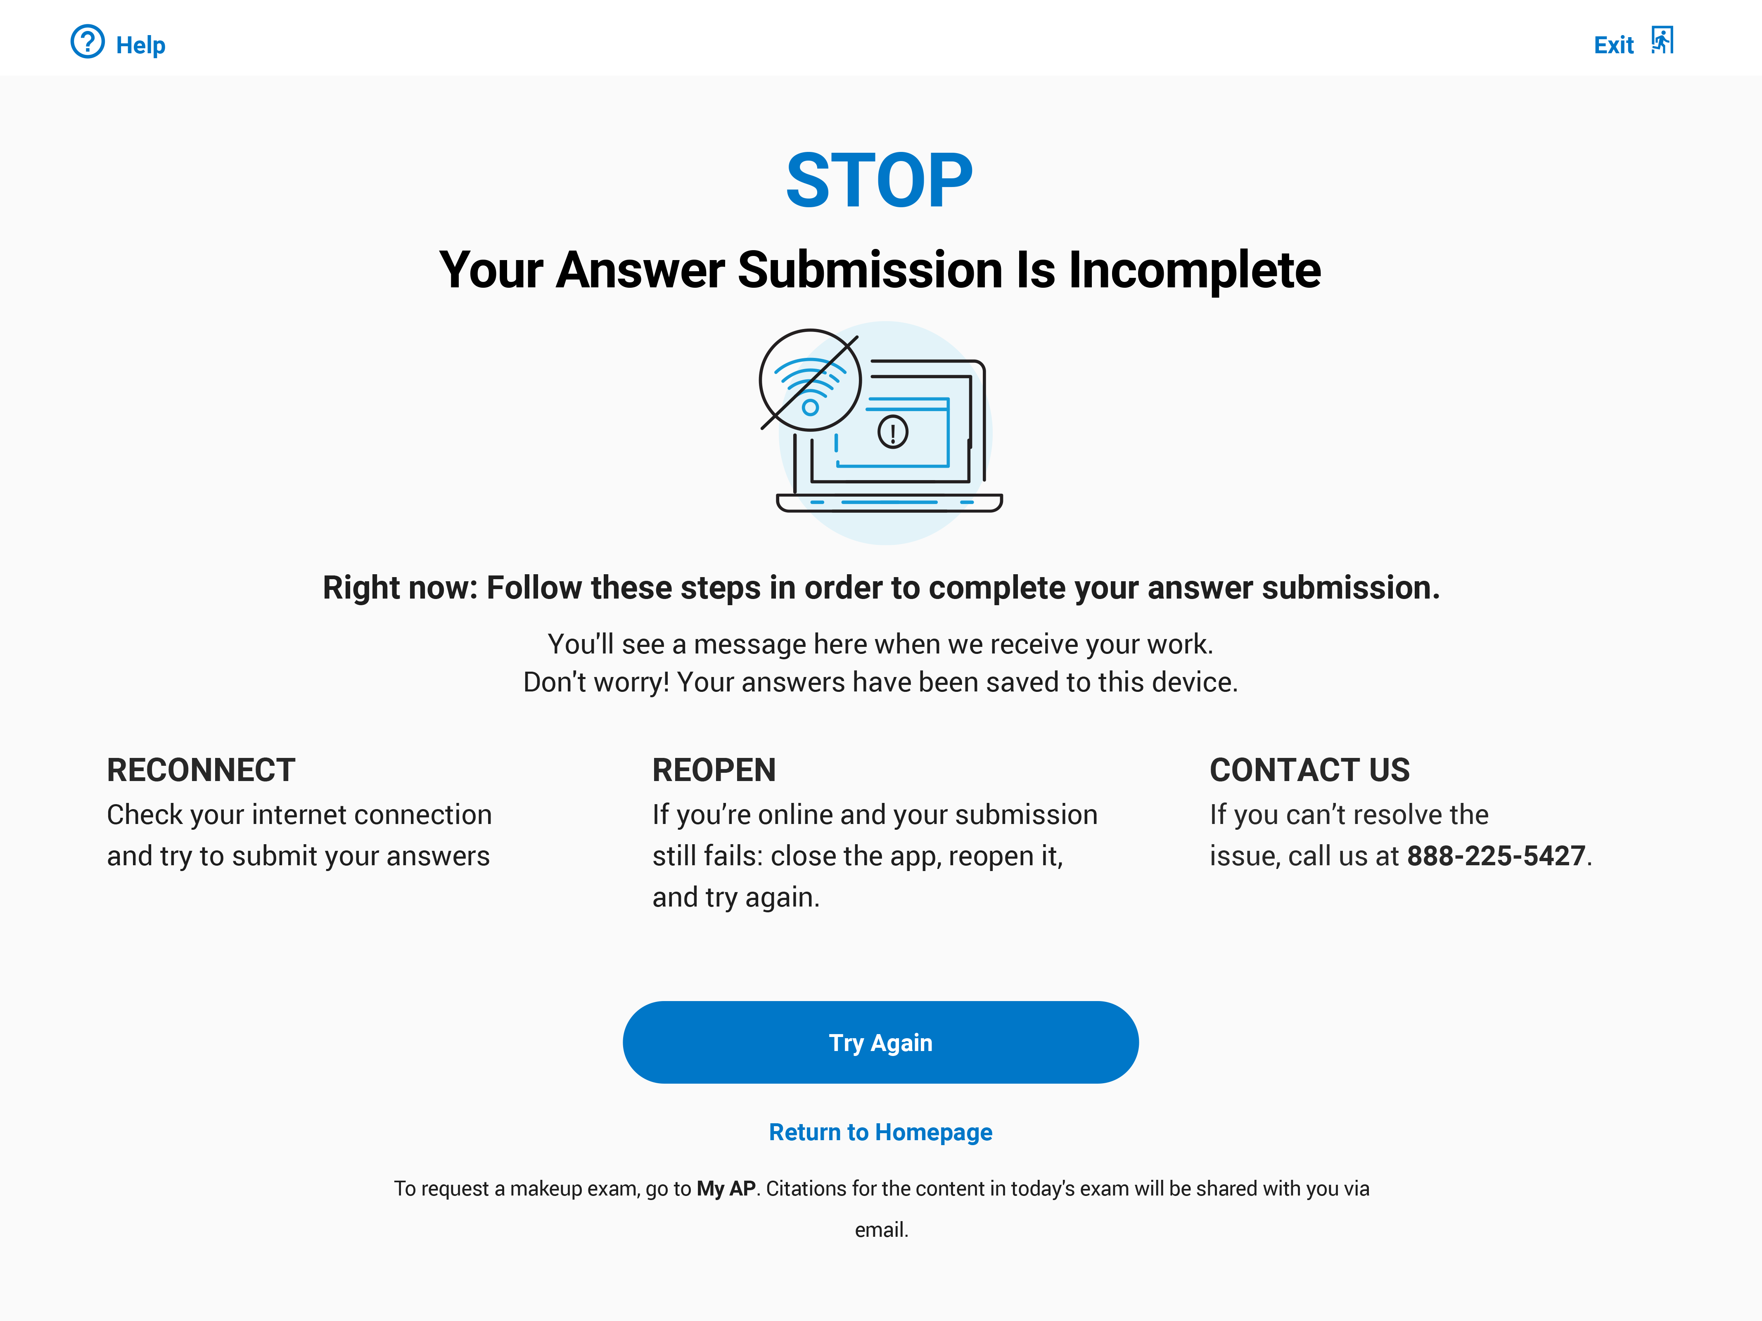
Submitting an Exam: Confirmation
The digital exam experience
When the exam is over, students’ answers will be submitted automatically. During the upload process, students will see the following screen, and they should not try to click anything, refresh the page, or exit the app.
successful submission
incomplete submission
For instructions, see the
AP Digital Testing Guide.

Slide 44
Submitting an Exam: Technical Difficulties
The digital exam experience
If answer submission fails—the most likely reason for this is the internet connection being down—the student will see this screen. The student’s answers are saved on the testing computer and they’ll have time to reconnect to the internet and get their responses uploaded.
Here’s what they should do:
Once the internet connection is reestablished, the student should click Try Again and their answers will resume uploading. When that process is complete the student will see the confirmation screen.
If their computer is connected to the internet, and the Try Again button is not working, they should click the Return to Homepage link. From the homepage, they should close the app, reopen it, and try again.
If none of these options work within 24 hours after the end of the exam, the student can call Customer Service at 888-225-5427.
IMPORTANT:
Students should not call Customer Service immediately. They should keep trying the above steps. If after 24 hours they aren’t able to upload their answers, they should get help from Customer Service.
For instructions, see the
AP Digital Testing Guide.

Slide 45
Testing Issues
Solutions to the most likely issues students may encounter on test day
Issue |  | Solution Steps
A Closed Exam If the app crashes or the student accidentally closes it during testing. |  | Restart the Testing App Relaunch the app and hit Resume Testing to get back to the question they were on.
Unresolvable Technical Problem If the student runs into a technical problem they can’t resolve during testing. |  | Exit and Relaunch the App Exit the app. If they’re able to relaunch the app, they should hit Resume Testing to get back to the question they were on.
Testing Disturbance If the student encounters a disturbance (e.g., an extended power outage) or any other issue that keeps them from doing their best on the exam. |  | Request a Makeup Students can go to My AP at myap.collegeboard.org and request a makeup exam.
IMPORTANT:
The testing timer will continue counting down while the app is closed.
For instructions, see the
AP Digital Testing Guide.

Slide 46
Additional Notes About Digital
AP Exams
6
Cover Page

Slide 47

Administering AP Exams in School
Where to go for policies and procedures
Paper Exams
Digital Exams
For in-school paper and pencil exams, AP coordinators should refer to the 2020-21 AP Coordinator’s Manual, Part 2 for AP Program policies and procedures.
Most policies for in-school digital exams are the same as the usual policies for traditional in-school paper and pencil exams. AP coordinators should continue to refer to the 2020-21 AP Coordinator’s Manual, Part 2 for overall AP Program policies and procedures and to the 2020-21 AP Digital Testing Guide for policies and procedures unique to digital exams.
For instructions, see the
AP Digital Testing Guide.

Slide 48
Administering Digital AP Exams in School
Information in the digital testing guide
Policies and Procedures
Exam Security
Exam Timing and Synchronous Start Times
Technology Staff
Proctors
Devices
Exam Locations/Exam Rooms
Preparing Students for Digital Exams In School
Exam Day Activities
AP Coordinator Checklist: In School Digital AP Exams
For instructions, see the
AP Digital Testing Guide.

Slide 49




Administering Digital Exams vs. Paper Exams
Key points of comparison between digital exams and paper exams
In-School Digital | Digital | In-School Paper | Paper
 | The digital testing application needs to be installed on each computer that will be used for testing. |  | Paper and pencil exams are delivered to the school, and AP coordinators need to receive and sort the delivery.
 | Students should practice using the digital testing application. |  | The digital testing application is not needed for paper and pencil exams.
 | Students must complete exam setup on the computer they'll use for the exam (setup must be completed before each exam subject a student takes). |  | No exam setup is required for students. Paper and pencil materials are handed out to students right before each exam.
 | Digital exams start automatically at synchronous start times worldwide with check-in 30 minutes before the scheduled exam start time. |  | Paper exams start at 8 a.m. and 12 p.m. local time, with a one-hour start time window so there's flexibility in student arrival times.
NOTE: For an at-a-glance comparison of policies for paper and pencil exams, in school digital exams, and at home digital exams, see the AP Exam Administration Planning Guide available at cb.org/ap2021planningguide.
For instructions, see the
AP Digital Testing Guide.

Slide 50
Accommodations for Digital Exams
Digital AP Exams were designed so all students can take them.
AP coordinators need to confirm students’ accommodations for digital exams through AP Registration and Ordering to ensure students receive the appropriate digital exam format for their accommodation.
On digital exams, accommodations will:
Be available for students with approved accommodations.
Be compatible with assistive technology (e.g., screen reader) and zoom functionality.
Be applied in a format that’s appropriate to a digital exam. For example:
Accommodation | Paper | Digital
Extended Time | Proctor accounts for extended time | The timer in the digital testing app automatically allocates the additional time for which the student is approved
Human Reader | Human reader | Screen reader
Large-Print Exam | Enlarged font size on printed book | Zoom functionality available through the digital testing application
IMPORTANT:
It’s especially important for students who plan to use assistive technology to practice navigating digital exams.
For instructions, see the
AP Digital Testing Guide.

Slide 51
Resources to
Help Prepare
7
Cover Page

Slide 52
Resources for AP Coordinators
Preparing for Digital AP Exams
Website | cb.org/ap2021
Downloads | collegeboard.org/apdownloads
Trainings | collegeboard.org/apcoordinatortraining
Discussion Groups | apcommunity.collegeboard.org
2021 AP Exam Planning Guide | cb.org/ap2021planningguide
2021 AP Exam Schedule | cb.org/apexamdates
Coming in April
Digital Exam Readiness Dashboard: AP coordinators will have access to a dashboard that helps them track their students’ progress in preparing for and completing digital exams.
Instructions for Proctors: Exam day instructions for proctors administering digital exams in schools.
Instructions for Tech: Assistive technology configuration instructions.
For instructions, see the
AP Digital Testing Guide.

Slide 53
Resources for AP Teachers and Students
Preparing for Digital AP Exams
Available now:
AP digital testing overview video: This short video gives students a basic understanding of digital AP Exams.
AP Central / AP Student: Find links to the exam schedule, all digital testing resources, answers to frequently asked questions, and more.
Available in late-March:
AP digital testing slideshow: Explore features of the digital testing application, learn how to get your device ready, and see how exam questions will be displayed.
Available beginning in April:
2021 Digital AP Exams Application: AP students and teachers can download the application and practice answering multiple-choice and/or free-response questions. They'll receive instructions April 8.
Digital Exam Readiness Dashboard: Educators will have access to a dashboard that helps them track their students’ progress in preparing for and completing digital exams.
For instructions, see the
AP Digital Testing Guide.

Slide 54
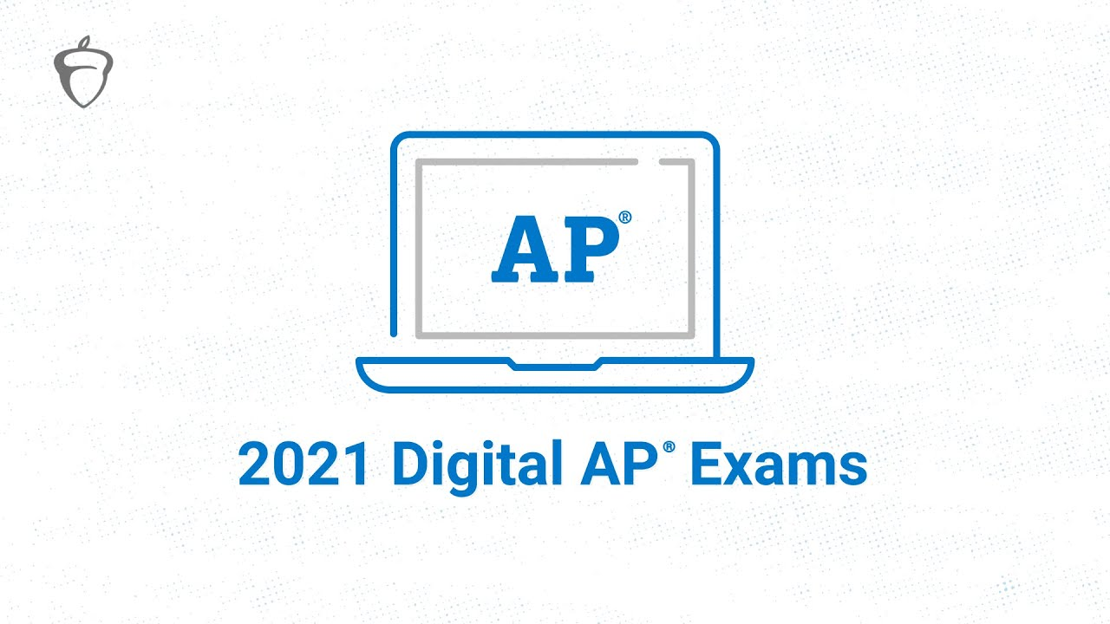
Introduce Students to the New App
2021 Digital AP Exams Overview
Watch
youtu.be/cUtHuYfPsFY
Take a look at the new digital testing app that AP students will use to take this year’s exams.
Share this video with your students to give them an overview of how they can use the new digital testing application.
For instructions, see the
AP Digital Testing Guide.

Slide 55
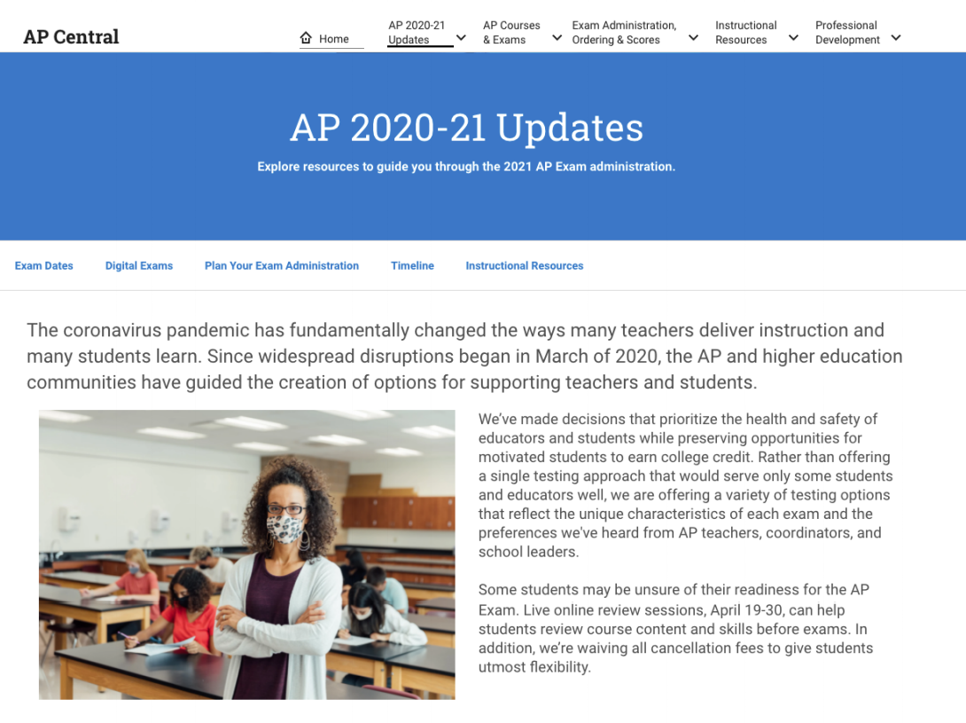
Visit AP Central® for more information
Visit AP Central® for more information
We’ll be updating the website with additional details as we have them.
For more about 2021 AP Exams, visit: cb.org/ap2021

Slide 56
Thank you!

