Slide 1

Growing Your
District’s
AP Program
Increasing Equity and Access
For more information, contact Lindsay Cooper.

Slide 2
Table of Contents
01
Master Scheduling
02
Growing and Sustaining
Your AP Program
03
Recommendations
04
School-Based Strategies

Slide 3
Section 01
Master Scheduling

Slide 4
Planning Forward: Effective Master Scheduling
Supporting your schools with data-driven decisions
Take advantage of AP Potential
  Identify courses that align with student’s strengths
  Evaluate course catalog: Do you offer courses that align with students’ strengths and interests?
  What areas of potential growth does the data show?
    How can you challenge and grow your students?
Survey Students
  What do students say they’re interested in?
Survey Teachers
  What do your teachers want to teach?
    What barriers do they identify?
    What possible holes in course offerings have they identified?
Evaluate historical section offerings:
    Are enough sections offered?
    Where are sections placed in the schedule? Do they conflict with frequently competing courses?

Slide 5
Planning Forward: Effective Master Scheduling
Where do we start and with what course?
Engaging students earlier in their high school careers with AP leads to better outcomes for all students.
Simply taking an AP course and its related exams set students up for greater success in additional AP courses as well as college:
  AP students, including those with average scores of 1 or 2, are more likely to enroll in a four-year college compared to academically similar students who did not take AP in high school.
  Students who earn AP scores of 2 are well prepared to succeed in introductory college coursework
  Many students who first score a 1 or 2 on an AP Exam will take further AP courses and score higher.
So where do start to have the greatest impact?
  Research suggests offering AP Human Geography in
  9th grade
  Then offer AP World History Modern, AP European History, AP Seminar, AP Computer Science Principles and AP World Languages and culture courses in 10th grade.

Slide 6
Section 02
Growing and Sustaining Your AP Program

Slide 7
Growing and Sustaining Your AP Program
Supporting your schools: District Led Strategies
Consider double blocking courses for
co-teaching opportunities
  i.e. AP History and English
Establish Personal Progress Checks
  Principals
  Teachers
  Students
Evaluate district scope and sequence for alignment with AP CEDs
  Supplement as needed
Set expectations for the use of AP Classroom
  AP Daily Videos
  Question Banks
  Formative Assessments

Slide 8
Set Up Students for Success
Recommendations for Course Placement
Grade 9
Grade 10
Grade 11
Grade 12
Seminar
French
Italian
Computer
Science
Principles
German
Spanish
Japanese
Chinese
Growing Your District’s AP Program

Slide 9
Section 03
Recommendations

Slide 10
Course Placement
AP Seminar
This course focuses on the development of critical thinking skills that are the foundation for success in many subsequent high school and college classes, so it is an especially good starting point for diverse students’ AP journeys.

Slide 11
HIGH SCHOOL BENEFIT:
Increased Performance in AP
Average 2017 AP Scores
NEXT-YEAR PERFORMANCE
Non-Seminar
Seminar (3+)
The skills taught in AP Seminar enhance other AP experiences.
AP Seminar students demonstrate stronger AP Exam performance on later AP Exams than their peers who didn’t take AP Seminar.
These results are consistent across race and ethnicity.
+6%
+7%
+8%
English
(Lang, Lit)
History
(Art, Euro, US, World)
Politics
(US Gov, Comp)
P value < 0.01 (all differences)
Notes: Results presented take into account student first-generation and minority status, gender, high school grades, PSAT/NMSQT® scores, number of AP Exams taken in the same subject area prior to AP Seminar, and number of other AP Exams taken prior to and concurrent with AP Seminar.

Slide 12
COLLEGE BENEFIT NO. 1:
Higher First-Year GPAs
Average First-Year College GPA
AP Seminar students were shown to outperform non-AP students in first-year college GPA.
AP Capstone courses emphasize academic skills, including:
  Investigating academic and real-world topics
  Interpreting and evaluating different perspectives
  Gathering and analyzing data
  Developing evidence-based arguments
  Communicating publicly
These results are consistent across race and ethnicity.
Non-AP
students
AP Seminar
students
AP Capstone Diploma recipients
P value < 0.01 (all differences)
Notes: Effects isolated by taking into account student first-generation and minority status, gender, high school grades, and SAT scores

Slide 13
COLLEGE BENEFIT NO. 2:
Greater Second-Year Retention
Probability of Second-Year Retention (%)
AP Seminar students have higher likelihood of persisting to the second year of higher education than their non-AP peers.
AP Capstone courses also emphasize non-academic skills, including:
  Managing long-term projects
  Meeting deadlines
  Collaborating in teams
These results are consistent across race and ethnicity.
Non-AP
students
AP Seminar
students
AP Capstone Diploma recipients
P value < 0.01 (all differences)
Notes: Effects isolated by taking into account student first-generation and minority status, gender, high school grades, and SAT scores

Slide 14
Course Placement
AP Computer Science Principles
AP Computer Science Principles offered to 9th or 10th graders can translate into enrollment in other STEM AP classes in subsequent years, particularly for female, Black and Latinx students. This course is an especially good invitation to AP because students who take AP Computer Science Principles in 10th grade are much more likely to major in Computer Science – qualifying students for many high-potential career opportunities nationwide, and this pattern is especially strong for Black and Latinx students.

Slide 15
HIGH SCHOOL BENEFIT:
AP CSP Students Persist in STEM
Increase in Subsequent AP STEM Participation
Associated with AP CSP Participation
7.2 pp
5.9 pp
5.7 pp
AP CSP students are 4.7 percentage points more likely to take AP STEM exams in high school than similar non-AP CSP students.
This is true across all student groups, particularly Black, Hispanic, and first-generation students.
4.7 pp
4.8 pp
2.7 pp
2.4 pp
Overall (60.0%)
Female
(62.8%)
Asian
(76.5%)
White
(59.1)
Black
(42.6%)
Hispanic
(48.9%)
First Gen
(53.7%)
Note: Horizontal axis numbers in parentheses are the percentage of the non-AP CSP students in the subgroup who take AP STEM exams. For example, 60% of non-AP CSP students take AP STEM, while 64.7% of AP CSP students take AP STEM for a 4.7 percentage-point increase associated with AP CSP participation.

Slide 16
COLLEGE BENEFIT NO. 1:
AP CSP Students Major in STEM
Increase in STEM Major Declaration
Associated with AP CSP Participation
15.2 pp
13.3 pp
13.4 pp
12.7 pp
AP CSP students are 11.6 percentage points more likely to declare a STEM major in college than otherwise similar non-AP CSP students.
AP CSP students are more likely to major in a STEM field, particularly Black, Hispanic, and first-generation students.
11.6 pp
9.8 pp
6.6 pp
Overall
(37.3%)
Female
(30.7%)
Asian
(47.6%)
White
(34.0%)
Black
(31.6%)
Hispanic
(32.4%)
First Gen
(35.0%)
Note: Horizontal axis numbers in parentheses are the percentage of the non-AP CSP students in the subgroup who declare a STEM major. For example, 37.3% of non-AP CSP students declare a STEM major, while 48.9% of AP CSP students declare a STEM major for a 11.6 percentage-point increase associated with AP CSP participation.

Slide 17
COLLEGE BENEFIT NO. 2:
AP CSP Students Earn Higher GPAs
Grade earned in sequent computer science course in college
0.59*
0.24*
0.20*
AP CSP students earn higher grades in sequent computer science courses than non-AP students who take the AP CSP-equivalent course in college.
AP Score 3
AP Score 4
AP Score 5
Non-AP CSP Students
AP CSP Students
P value < 0.01
Source: 2017 and 2018 Cohort

Slide 18
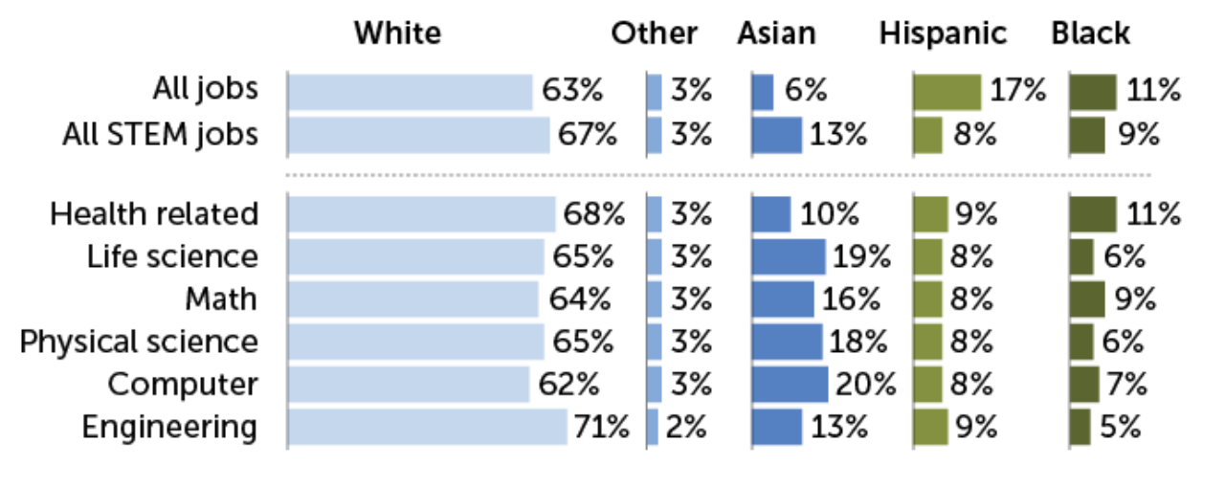
WORKFORCE BENEFIT:
AP CSP Can Help Diversify STEM
Racial and ethnic representation in STEM jobs, 2017–19
Employment data 2017–19 show that Black and Hispanic professionals are underrepresented in STEM, compared with their share of the overall U.S. workforce.
PEW RESEARCH CENTER, E. OTWELL/SCIENCE NEWS
Source: https://www.sciencenews.org/article/science-technology-math-race-ethnicity-gender-diversity-gap

Slide 19
Course Placement
AP World Languages
AP Chinese Language and Culture
AP French Language and Culture
AP German Language and Culture
AP Italian Language and Culture
AP Japanese Language and Culture
AP Spanish Language and Culture
AP Spanish Literature and Culture

Slide 20







Empower Heritage Speakers
Offer AP World Language Courses in Grades 9 and 10
In schools with large populations of heritage speakers, AP world language courses can also be used to serve as a pathway to other AP classes.
The key is to provide students with an initial AP experience that is successful so that they build confidence in their ability to tackle AP coursework and begin to identify as AP students.

Slide 21
Section 04
School-Based Strategies

Slide 22
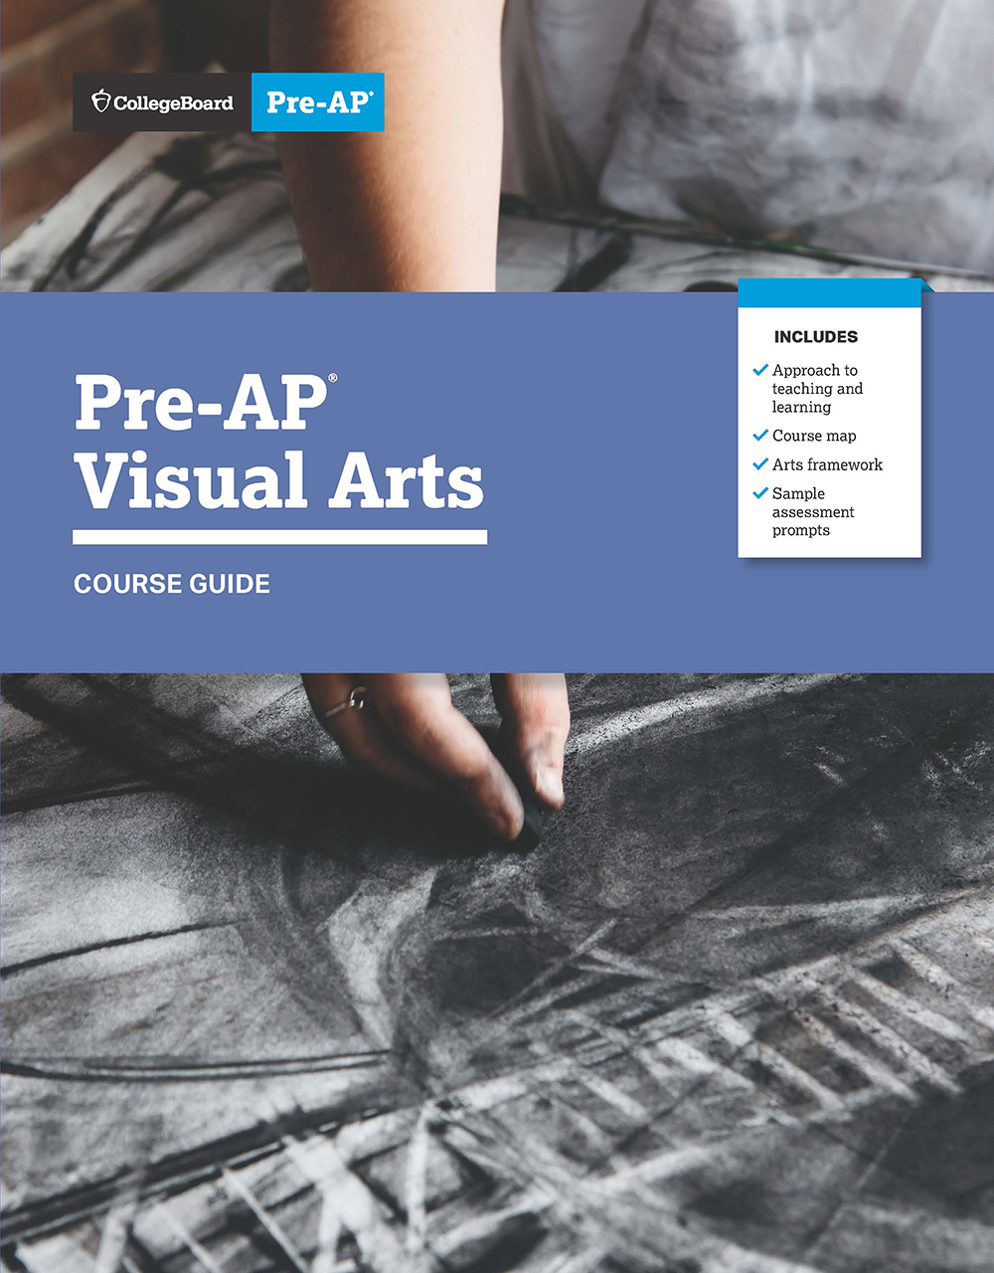
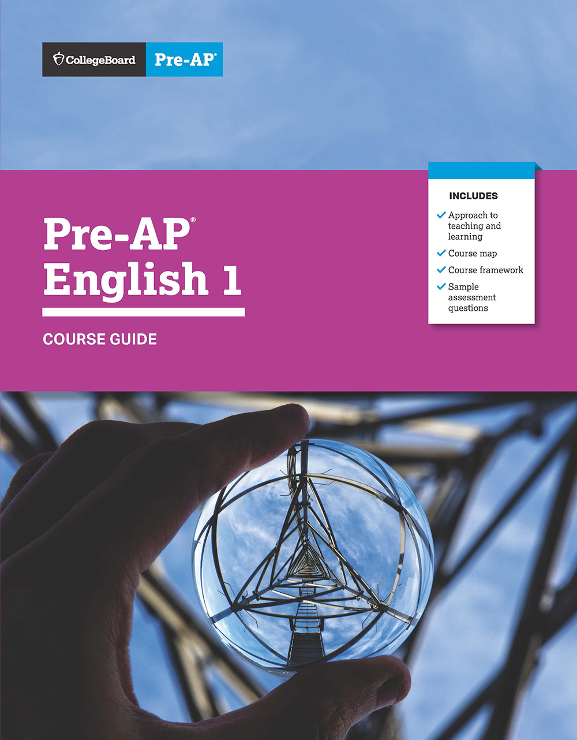
School based strategies
Pre AP
Consider adoption of Pre-AP Courses
In Pre-AP, students have frequent opportunities to engage deeply with texts, sources, and data, as well as compelling higher-order questions and problems.
Across Pre-AP courses, students experience instructional practices and routines that help them develop the important critical thinking skills needed to succeed in AP.
Pre-AP courses are directly back-mapped from specific AP courses and often include strong connections to multiple AP courses.

Slide 23
Pre-AP Course | AP Course Connections
Pre-AP English 1 & 2 | AP Seminar | AP English Language and Composition AP English Literature and Composition
Pre-AP World History & Geography | AP United States History AP World History: Modern | AP European History AP Human Geography
Pre-AP Biology | AP Environmental Science | AP Biology
Pre-AP Chemistry | AP Environmental Science | AP Chemistry
Pre-AP Algebra 1 | AP Statistics | AP Computer Science Principles AP Calculus AB or AP Calculus BC
Pre-AP Geometry with Statistics | AP Statistics | AP Calculus AB or AP Calculus BC
Pre-AP Algebra 2 | AP Physics 1: Algebra-Based AP Physics 2: Algebra-Based | AP Calculus AB or AP Calculus BC AP Statistics
Pre-AP Visual Arts | AP Drawing | AP 2-D Art and Design AP 3-D Art and Design

Slide 24
Equity and Access
Supporting Open Enrollment
Audit systems and processes for unforeseen/unintentional barriers
  i.e., unnecessary prerequisites, GPA Requirements, Teacher Recommendation letters, applications, interviews, etc.
Provide professional development to faculty and staff
  Retention strategies for diverse student groups
  Culturally relevant teaching
  Mentoring for teachers and students
  AP Mentoring is available in more subjects than ever before
AP recruitment nights
  Culturally relevant

Slide 25
Open Enrollment Supports
Agenda Template
1
District Philosophy on
Advanced Coursework
2
Overview of AP
What is it?
Who is it for?
Why should I take it?
3
Teacher testimonials
What does the AP Classroom
look like?
What can I expect as an AP Student?
4
Student testimonials@
What does the AP Classroom
look like?
What can I expect as an AP Student
5
Q & A time for teacher and student panelists
6
Breakout groups by subject
Allow students and families time to explore the courses offered at each school
Provide translation services for schools/districts most common languages

Slide 26
Retention
District supported strategies for campuses
Extended drop deadline
  Freeze on the ability to drop AP courses prior to the first 3 weeks of the course
Intentional, scheduled interventions for students with a 75 and below
  Led by counselors, assistant principals, instructional coaches
  Not solely the prerogative of the classroom teacher
  Ongoing throughout the year
Develop a cohort model to bridge gaps in learning and access, especially for rising 9th graders.
  Cluster grouping
  Student to Student mentors

Slide 27
Promoting Equitable Access for All Students
Identifying your students
Access all data points available: i.e., Cogat, NNAT, state assessments, instructional benchmark assessments, PSAT.
Identify target populations and set goals on campus
  STEM focus
  Arts and Humanities Focus
  College Readiness
  Career Prep
  Identify courses that meet the needs of the goal and align with AP Potential data for your student group.
Align campus staffing to cover goal
Parent meetings beginning in 8th grade
  Provide translation services for most common languages

Slide 28
Promoting Equitable Access for All Students
AP Bridge program examples
Promote the development of academic skills required for completion of AP Calculus by the Senior year
  AP Pre Calculus
  The Mathematical Association of America has described Americans’ struggle with math as “the most significant barrier” to completing both STEM and non-STEM degrees.¹
Promote the development of academic skills required for completion of AP English Language and Composition by Junior Year.
Develop soft skills needed for success in post-secondary pathways, college, career, military
  AP Seminar
  AP Research
¹ “A Common Vision” Mathematical Association of America (MAA) https://www.maa.org/sites/default/files/pdf/CommonVisionFinal.pdf

Slide 29
AP Course Pairings
Are you offering the full pair of companion courses?
AP Biology pairs with AP Environmental Science
AP Biology pairs with AP Psychology
AP English Language and Composition* pairs with AP English Literature and Composition*
AP U.S. Government and Politics pairs with AP Macroeconomics
AP English Language and Composition pairs with AP United States History
AP Human Geography pairs with AP Environmental Science
AP Physics 1: Algebra-Based pairs with AP Calculus AB
AP Research pairs with AP Statistics
AP Art History pairs with AP World History: Modern
AP Seminar (grade 10 or 11) pairs with AP Research (grade 11 or 12)
AP Seminar (grade 10) pairs with AP English Language and Composition (grade 11), then AP Research (grade 12)
* Please note that colleges typically will only grant credit for one of the two AP English courses.

