Slide 1

New to AP?
Here’s where to start.
®
Getting Started with AP: The Basics
Summer 2022

Slide 2
Table of Contents
01
Overview
02
Engaging Students
03
Engaging Teachers
04
Engaging Families
05
Getting Started with AP
06
Equity and Access
07
Next Steps

Slide 3
Section 01
Advanced Placement:
An Overview
®

Slide 4
AP by the Numbers 2021
1.47M
examinees earning
3 or higher
In Mississippi,
Nebraska, South Dakota, and Tennessee,
students earned more qualifying scores
in 2021 than in 2020
4.5M
exams taken
MS
NE
$2.6B
in potential savings
in tuition and fees
for students and families
SD
TN

Slide 5
AP by the Numbers 2021
American History/U.S. History
Biology
Chemistry
English
European History
French
German
Latin IV (fourth-year Vergil)
Latin V (prose, comedy, lyric)
Mathematics
Physics
Spanish
Research
Seminar
2-D Art and Design (formerly Studio Art)
3-D Art and Design (formerly Studio Art)
Drawing Art and Design (formerly Studio Art)
Art History
Biology
Calculus AB
Calculus BC
Chemistry
Chinese Language and Culture
Computer Science A
Computer Science Principles
English Language and Composition
English Literature and Composition
Environmental Science
European History
French Language and Culture
German Language and Culture
Government and Politics (Comparative)
Government and Politics (U.S.)
Human Geography
Italian Language and Culture
Japanese Language and Culture
Latin
Macroeconomics
Microeconomics
Music Theory
Physics 1: Algebra-Based
Physics 2: Algebra-Based
Physics C: Electricity and Magnetism
Physics C: Mechanics
Psychology
Spanish Language and Culture
Spanish Literature and Culture
Statistics
U.S. History
World History: Modern
Coming Soon: Precalculus
Coming Soon: African American Studies
2022
38 Courses (and 2 coming soon)
1956
12 Courses

Slide 6




Who We Are and What We Do
The College Board's Advanced Placement Program (AP) is a collaborative community of AP teachers and students, states, districts, schools, colleges,
and universities committed to the
daily work of developing college-level knowledge and skills.
We’ve been delivering excellence
in education to millions of students
across the country since 1955.
The program consists of college-level courses developed by the AP Program that high schools can choose to
offer, and corresponding exams that
are administered once a year.

Slide 7
How It Works
Getting teachers started
Teachers design
their own courses
We provide a detailed
set of expectations
for course content through a Course Exam and Description (CED).
Teachers create
their own syllabi or borrow existing, approved syllabi.
Teachers submit their
syllabi to the AP Course
Audit for approval.
This ensures teachers’
AP courses cover the content required by higher education and makes AP flexible
and accessible for students and schools.
Learn more about the Course Audit process here.

Slide 8

What is an AP Exam?
Each AP course concludes with an AP Exam.
  These assessments are designed by the same expert committees that designed the course.
The exams are scored on a scale of 1 to 5 by college and university professors and experienced AP teachers.
  Many U.S. colleges offer credit for AP Exam scores of 3 or higher.
AP Exams are administered at authorized schools and test centers. Most high schools that offer AP courses choose to administer AP Exams to their own students as well as external AP students.
Schools that opt not to administer AP Exams can refer students to another AP testing location.

Slide 9
Let’s Talk About AP Exam Scoring
1–5, what does it mean?
We use the steps below to define the knowledge and skills required to earn scores of 1, 2, 3, 4, and 5 on an AP Exam.
1
2
3
Develop ALDs.
First, committees of college faculty who teach the comparable college course develop detailed descriptions of the performance required to earn each score—these are called achievement-level descriptions (ALDs).
Conduct standard-setting studies.
During a standard-setting study, a panel of 15 faculty and teachers reviews the ALDs and determines how many questions a student would need to answer correctly at each ALD. These raw scores become the cut scores for each AP Exam score.
Conduct college comparability studies.
The same committees administer portions of an AP Exam to students in their related college course; student AP scores are correlated to their final course grades. The results of both studies establish the standards and inform the cut scores for the relevant AP Exam.

Slide 10
How are AP Exams scored?
The multiple-choice sections of AP Exams are scored by computer.
The free-response sections and through-course performance assessments, as applicable, are scored by experienced
AP teachers and college faculty who have expertise teaching corresponding college courses.
Most are scored at the annual AP Reading, while a small portion is scored online.
Approximately half of the AP readers are college faculty.
The chief reader for each exam develops scoring rubrics for free-response questions, oversees day-to-day scoring activities, and selects AP readers and Reading leadership. The chief reader is always a college or university faculty member.
Readers undergo rigorous training to ensure that they have a thorough understanding of the scoring rubrics. Their work is monitored throughout the Reading for fairness and consistency.

Slide 11
Section 02
Engaging Students
“The AP credits I received allowed me to skip straight to higher-level, more demanding courses in my major.”
— Tyler V., University of Washington

Slide 12
Why should I take AP?
Let your students know:
AP builds students’ skills and confidence.
AP students learn essential time management and study skills needed for college and career success.
They dig deeper into subjects that interest them and learn to tap their creativity and their problem-solving skills to address course challenges.
AP helps students get into college.
Students who take AP courses send a signal to colleges that they’re serious about their education and they’re willing to challenge themselves with rigorous coursework.
85% of selective colleges and universities report that a student’s AP experience favorably impacts admissions decisions.

Slide 13

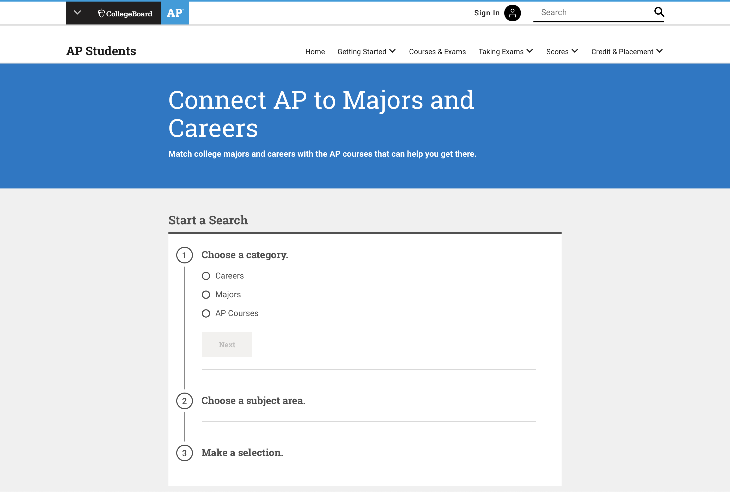
A Head Start in High School
AP also helps your students
Discover Their Passion
  Studying a subject in depth could give your students new insights and even put them on the path to a career.
Boost Their GPA
  Taking an AP course and exam can boost your students’ GPA. Check with your school for more information.
Determine a Path to Their Future
  Use our tool to see which AP courses can help your students on the path to specific careers or college majors.
Explore careers and majors

Slide 14
Section 03
Engaging Teachers
A Head Start in High School
Research consistently shows that AP students are better prepared for college
than students who don’t take AP, regardless of their exam score. They’re more likely to enroll and stay in college, do well in their classes, and graduate in four years.

Slide 15
Does AP really help all my students?
Succeed in college.
Research shows that students who receive a score of 2 on their AP Exams are ready for college work.^{[3]}
Research shows that students who receive a score of 3 or higher on AP Exams typically experience greater academic success in college and have higher graduation rates than their non-AP peers.^{[4]}
3 out of 4 AP students enrolled
in a 4-year college start school with some AP credit.^{[5]}

Slide 16

What supports do my teachers have?
Getting started with AP has never been easier.
In addition to myriad professional learning opportunities, teachers have direct classroom support at their fingertips through AP Classroom.
AP Classroom includes:
  Unit Guides
  Videos
  Progress Checks
  Question Banks
  Reports

Slide 17
Encourage AP teachers to Use AP Classroom!
Key Features
Unit Guides provide an outline of the exact content and skills covered on the exam and include Topic Pages, which describe the content for each topic.
Progress Checks assess student understanding of topics and skill within a unit through multiple-choice and free-response questions.
AP Daily is a series of on-demand, short videos that teachers can assign to students*, saving direct class time to focus on areas where students need help.
The My Reports section can help teachers recognize student achievement and prioritize areas for extra support by pinpointing strengths and weaknesses.
Topic Questions are formative questions that teachers can use to check student understanding of content and skills as each topic is taught.
The Question Bank is a searchable database of real AP questions that teachers can use to create customized practice, online or on paper.
AP teachers access AP Classroom by signing in at myap.collegeboard.org.
*AP Daily videos are always visible and available to all students, including students in Exam Only sections, regardless of whether teachers have assigned them.
Topic Questions, Progress Checks, and Question Bank assessments are only visible to students if a teacher assigns them.

Slide 18
Section 04
Engaging Families
Half of the students entering four-year colleges are now starting college with some credit from AP. Ensure your student is set up for success with AP courses and exams.

Slide 19

Does AP really save me money?
Save time and money in college.
Research shows that students who take AP courses and exams are much more likely than their peers to complete a college degree on time^{[6]}—which means they avoid paying for, for example, a fifth year of tuition.
Most colleges and universities nationwide offer college credit, advanced placement, or both for qualifying AP Exam scores. This can mean:
  Fulfilling graduation requirements early
  Being able to skip introductory courses or required general-education courses

Slide 20
Section 05
Getting Started with AP
For District Leaders

Slide 21

Where do I start?
AP Potential™
If your schools give the SAT® Suite of assessments, you can use this free, research-based tool right now.
AP Potential supports access to AP for all academically prepared students
Develop a robust AP program by identifying whether your school should expand its course offerings and/or increase the number of sections of AP courses already offered
Reduce time to recruit new AP students
Meet college and career readiness accountability measures
Learn More Here

Slide 22


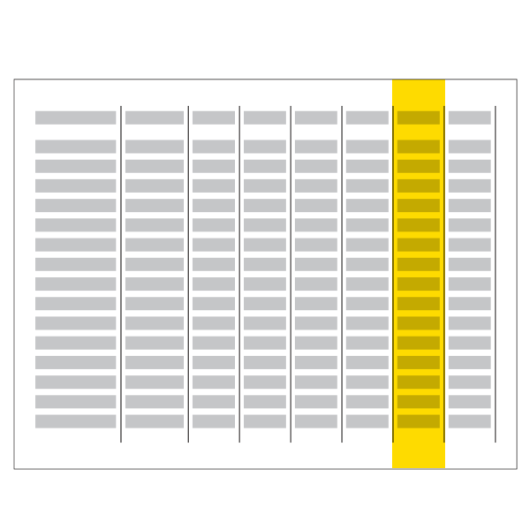
What You’ll Get with AP Potential™
Rosters that show all students in the selected grade(s) who have the potential to succeed in
AP courses. District-level users can generate a single roster for all schools in their district.
Customized letters that you can send to parents/guardians to inform them of their child’s AP potential.
The ability to sort your rosters by such characteristics as race/ ethnicity or gender to support school, district, or state-level equity and access goals.

Slide 23
What else can I use?
Teacher Feedback and Data
  What students are motivated?
  What does parental support look like?
  How prepared are the students?
  What are the student’s postsecondary goals?
  Performance in classes
Additional Assessment Data
  State assessments
  SAT Suite of Assessments
  ACCUPLACER®
  AAPPL for AP languages
  CoGat/NNAT
Student Feedback
  What are they interested in?
  What are the credit policies at most frequently attended colleges and universities?

Slide 24
Section 06
Equity and Access
Investing in Equal Opportunity

Slide 25

Setting Your Schools Up for Success
AP courses are open enrollment
Offer gateway courses like AP Seminar and AP Computer Science Principles
Get student buy-in, require 6 weeks in the course before allowing students to consider dropping.
Provide Pre-AP® and/or honors-level course work in middle school and high school

Slide 26
District-Level Strategies
Create district-level AP guidelines
Engage your teachers in AP curriculum writing
Create AP liaisons at each campus and target
AP communication through them
Provide district-level support through dedicated
AP leadership position or positions
Take advantage of in-person and virtual professional learning throughout the year
  APSI & AP Workshops
  Teacher Webinars
  AP Community
  AP Mentoring
Use your data
  Lead conversations at the district and campus level
  Include campus leaders, teachers, and students
Set goals related to equity and access
  What gaps are you trying to close?
  What populations are underrepresented?
  Align campus AP goals to district AP goals.
Communication
  Keep the community informed
    AP nights, webinars, social media

Slide 27
Section 07
Next Steps
Getting a Professional Account

Slide 28
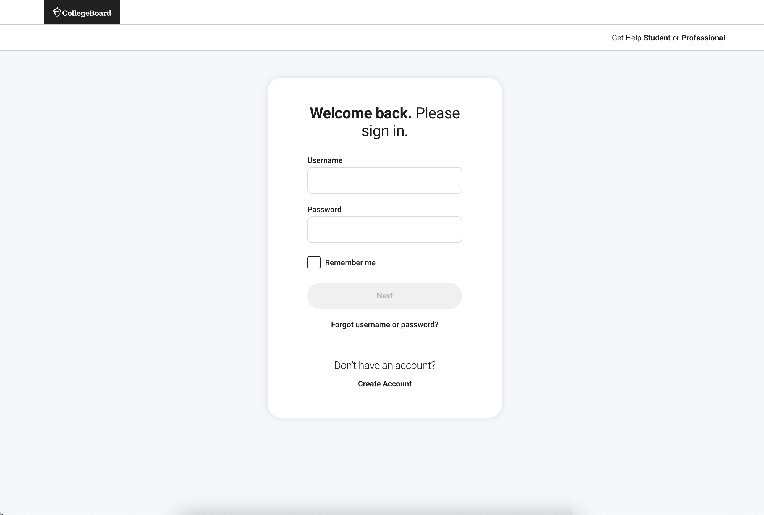
How do I access these tools and resources?
You need a College Board Professional Account
  Don’t have one? Sign up here
Once you’ve created your account, you’ll be able to add the tools that work for you and your role.
  Not sure what each tool does or how to get access codes?
  Check out this presentation, on who does what or visit our District Administrators website.

Slide 29
Thank You!

