Slide 1

AP Classroom for District Leaders
Summer 2022

Slide 2
Table of Contents
01
AP® Classroom: What’s new
02
AP Classroom: Big Picture
03
Reports: What they do

Slide 3
AP Classroom:
What’s new

Slide 4
AP Classroom 2022-23
Question Bank
Update
Quiz
Building
Progress Check Location Change
You can now filter more precisely by using the Include Only and, for filter categories taught sequentially (Units and Topics), Include No Later Than options. For example, you can use these to filter for questions tagged to Unit 3, but not also tagged to Unit 4 or later. You can also use the “Include” filter option to get the same kind of results as last year.
You can now name a quiz before adding any questions, remain on the list of questions to add or remove any of your choosing until you’re done, and assign or preview a quiz more easily.
Like other assessment types, Progress Checks will initially be on your Unassigned page, and students will not see Progress Checks in their Course Resources or their assignment lists until you assign them.

Slide 5
AP Classroom:
Big Picture

Slide 6
What you’ll find in AP Classroom
Key Features
Unit Guides provide an outline of the exact content and skills covered on the AP Exam and include Topic Pages, which describe the content for each topic.
Progress Checks assess student understanding of topics and skill within a unit through multiple-choice and free-response questions.
AP Daily is a series of on-demand, short videos that teachers can assign to students*, saving direct class time to focus on areas where students need the most support.
The My Reports section can help teachers visualize student progress and prioritize areas for extra support by pinpointing strengths and weaknesses.
Topic Questions are formative questions that teachers can use to check student understanding
of content and skills as each topic is taught.
The Question Bank is a searchable database
of real AP questions that teachers can use to create customized practice, online or on paper.
AP teachers access AP Classroom by signing in at myap.collegeboard.org.
*AP Daily videos are always visible and available to all students, including students in Exam Only sections, regardless of whether teachers have assigned them.
Topic Questions, Progress Checks, and Question Bank assessments are only visible to students if a teacher assigns them.

Slide 7

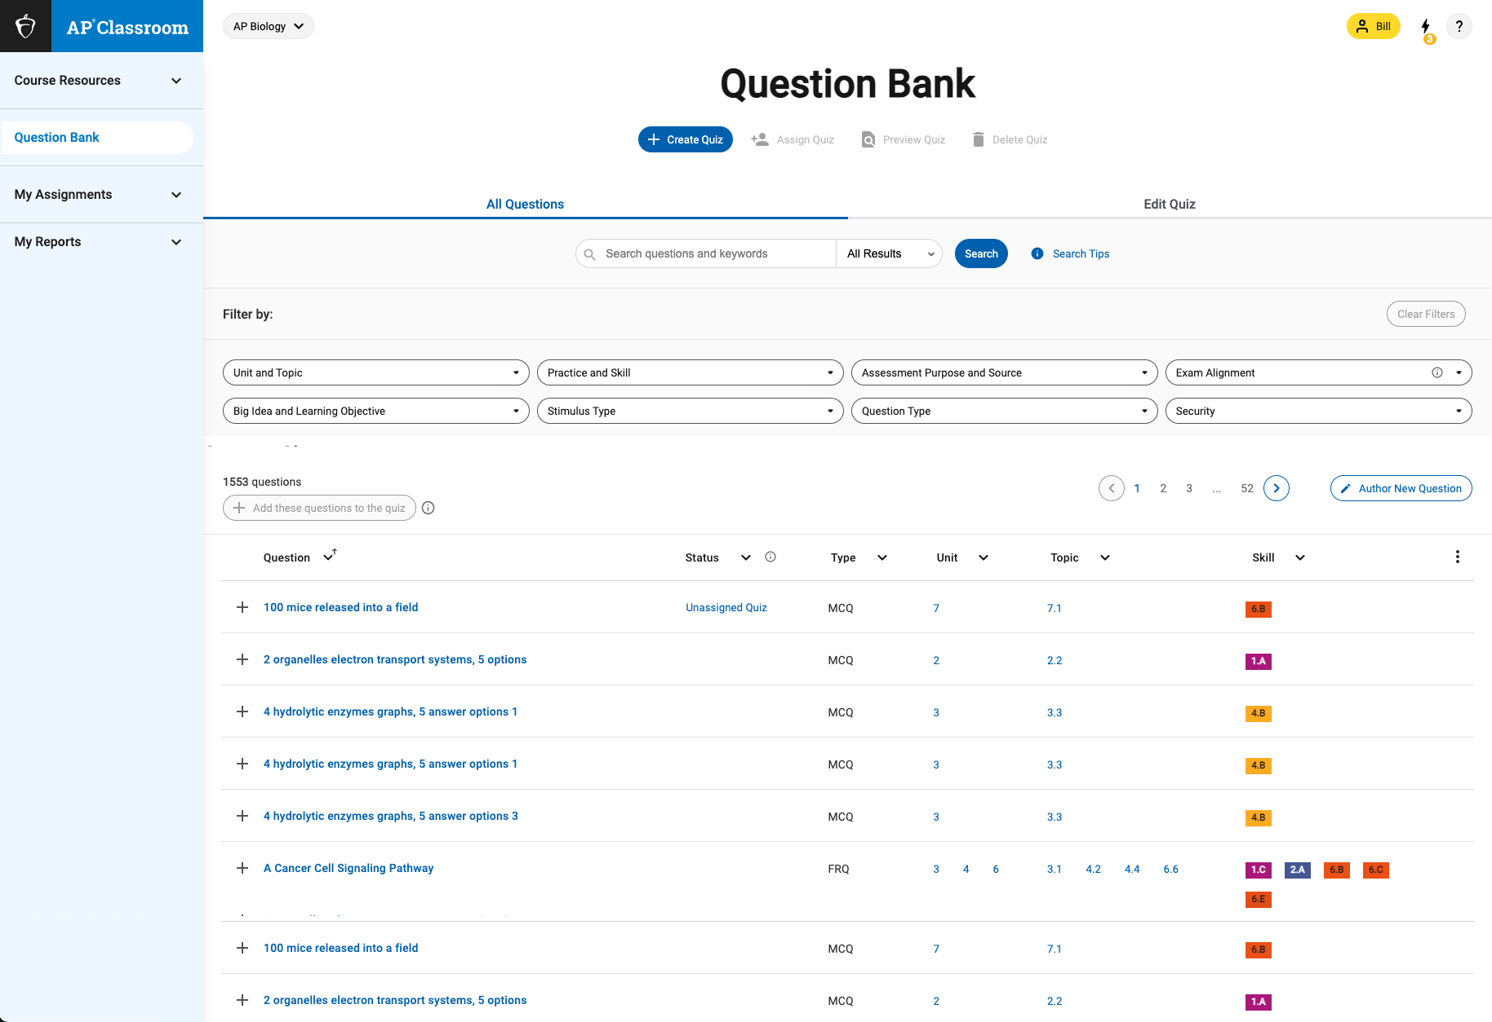
Question Bank
The Question Bank has thousands of questions teachers can assemble into custom assignments for students.
Every question is indexed according to the elements of the course framework so teachers can easily find questions that address certain concepts and skills."
AP Practice Exams and their questions are also available in the Question Bank for assignment to students.
Practice Exam Security Attestation
Practice exam questions must remain as secure as possible, so they are available for all teachers to use in their classrooms. You will need to agree to specific security measures when using practice exam questions.
These measures are included in an on-screen attestation you will see when you first visit the Question Bank.

Slide 8
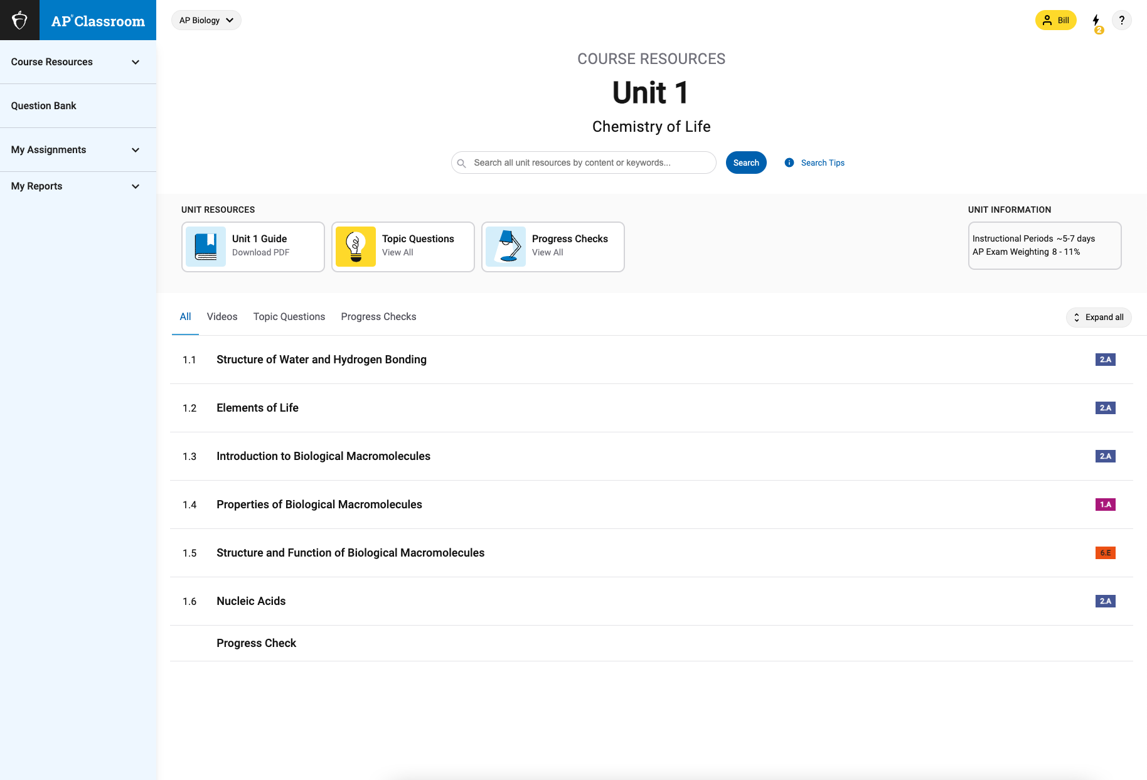
Course Resources
Unit at a Glance
For AP courses using the unit structure, the course resources section of AP Classroom corresponds to the "Unit at a Glance" topics and skills for each course as included in the Course and Exam Description.
Skills are color coded just like in the CED to help teachers see how the skills are spiraled, or repeated, across units.
When you first log into AP Classroom, the Course Resources section will open to Unit 1. After subsequent log-ins, the Course Resources section will open to the
last unit visited.

Slide 9
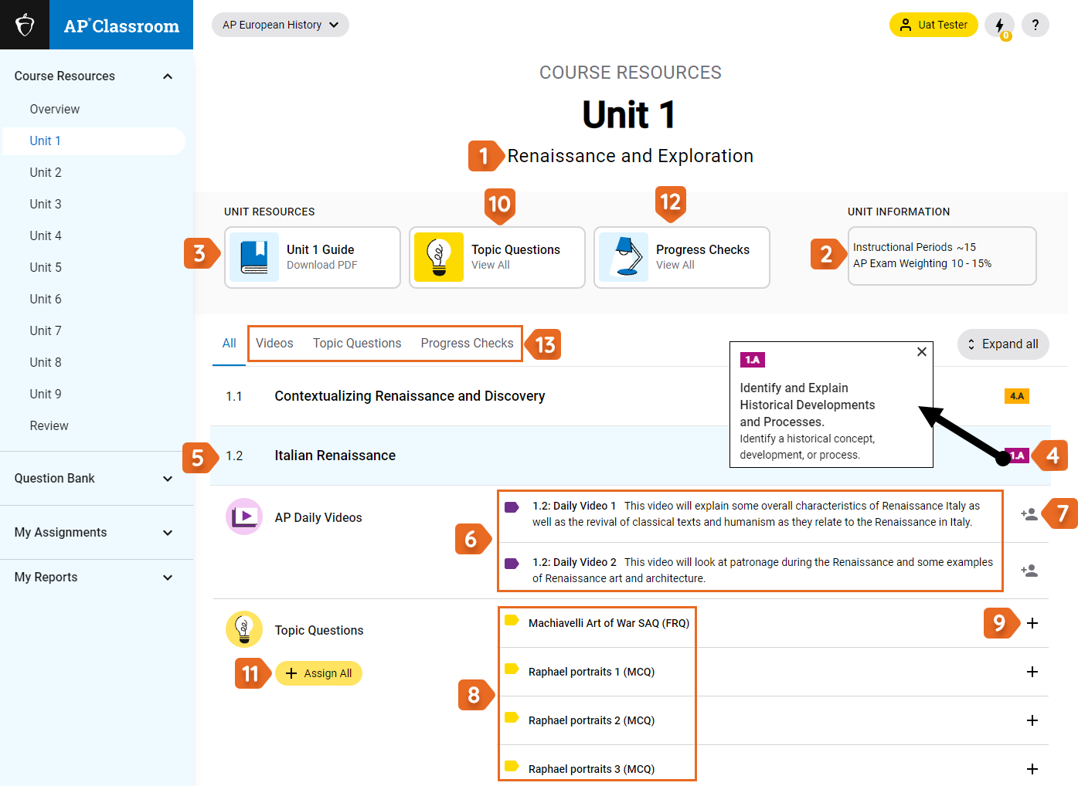
Unit 1
Course Resources Page
The following numbers and descriptions correspond to the numbers outlined on the next slide.

Slide 10
Unit 1 Course Resources Page
The following numbers and descriptions correspond to the numbers outlined on the previous slide.
Unit Title.
The number of instructional periods for the unit and the approximate percentage the unit makes up on the AP Exam.
PDF downloadable version of the unit guide (great for substitutes).
Skill for the topic.
Topic title.
AP Daily Videos
Assign video to the entire class. The video can also be assigned to individual students.
Topic Questions.
Click on the plus icon to add individual questions to the Quiz Builder.
Select the panel to view all Topic Questions for each topic of the unit at once.
Assign All: Option to automatically create a quiz that contains all topic questions.
Progress Checks: View for the selected unit.
Filters to see a specific type of resource only
*Courses that are structured without Units are organized similarly, just without the unit labels.
AP Art and Design
AP Computer Science Principles
AP Research
AP Seminar

Slide 11
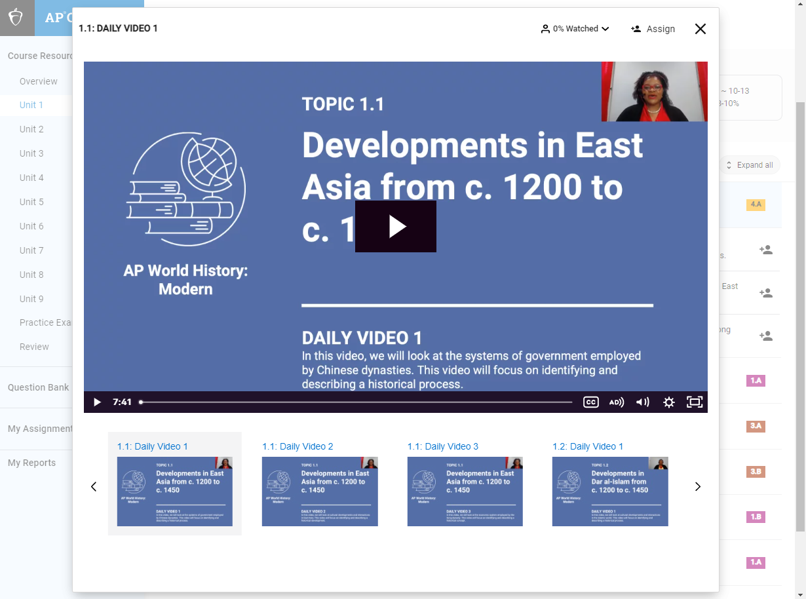
AP Daily Videos
Monitoring Student Viewing
AP Daily is a series of short, on-demand videos that provide instruction on the content and skills of each topic throughout a course. Students can view these videos on their Course Resources page at any time, regardless of whether a teacher assigns them.
You can track student viewing in three ways:
  Open the video player and select the “Watched” drop-down.
  In My Assignments, click All Assignments or Active.
  Open the My Reports page and select the “All Assignments” view.
Students must watch 95% or more of the video to be counted as viewed.

Slide 12
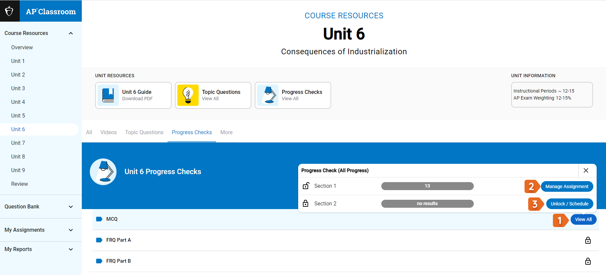
Progress Checks
Once teachers have assigned progress checks from the Course Resources page, they can also monitor student progress in the Progress Checks tab.
In this example, the MCQ progress check has been assigned to one course section.
Select View All to see the details.
Select Manage Assignment to go to the assignment detail screen for the section 1 assignment.
To unlock the progress check for section 2, select the Unlock/Schedule button.
Notes:
A note here: The "View All" option only exists if the PC has been assigned to at least one section (or individual students in at least one section). Else, teachers will see the lock icon like what appears for the "FRQ Part A" PC in the screenshot.
Also, the "View All" option brings up the popup window that is shown in the screenshot. If teachers want to preview the PC questions, they'll need to click on the actual "MCQ" title to see them.

Slide 13
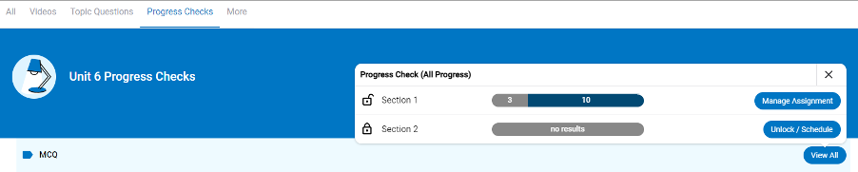
Progress Checks
As your students begin to take a Progress Check, colored bars will appear to capture their changing status. In this example, 10 students in section 1 have completed the assignment.

Slide 14
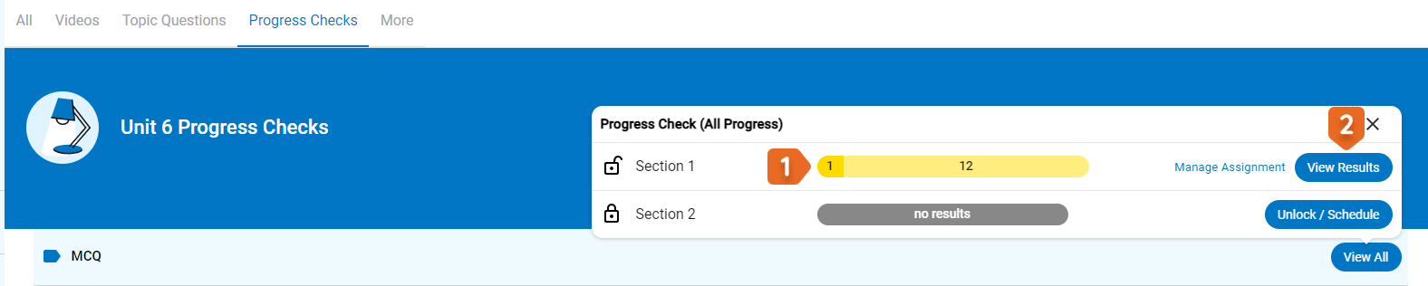
Progress Checks
When the students complete an assignment, the bar indicates class performance.
Click View Results for more details.

Slide 15
Reports: What they do

Slide 16
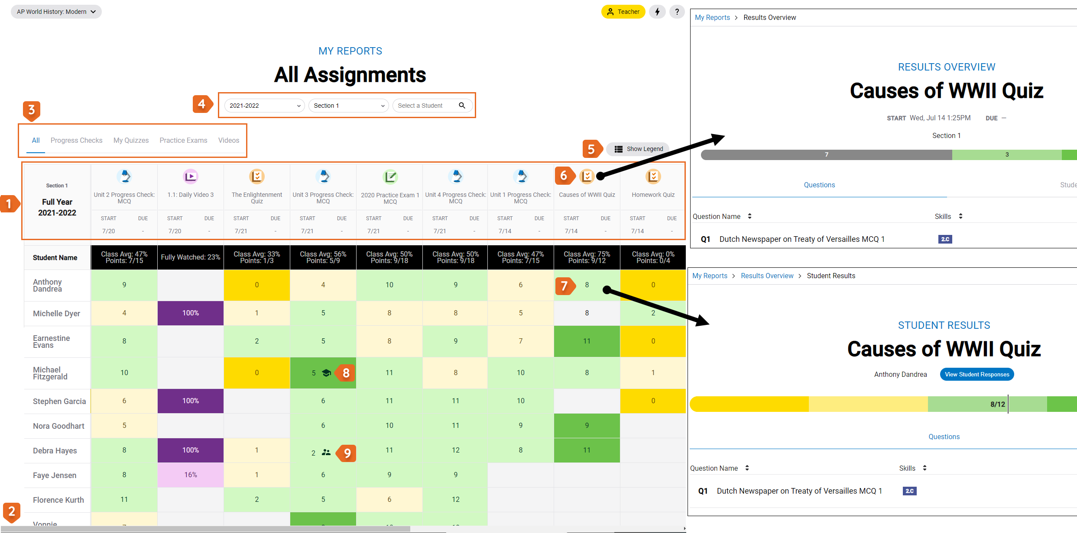
My Reports: All Assignments

Slide 17
My Reports: All Assignments
From the My Reports - All Assignments page, you have access to the results for all AP® Classroom assignments: progress checks, topic question quizzes and quizzes you create, practice exams, and videos.
  All the assignments are displayed at the top of the table [1], with students’ names listed in the left column.
Use your browser's horizontal scroll bar [2] to see the full table and list of all assignments if necessary.
Use the assignment type filters [3] to limit the display by assignment type.
Use the drop-down filters at the top of the page [4] to restrict results by, if applicable, school year, class section, and individual student.
Select Show Legend to see how color-coding is used on the chart [5].
Select the name of the assignment [6] to go to its Results Overview.
Select a box on the table [7] to see detailed results for a student on the assignment.
A cap icon [8] indicates the student self-scored the assignment and the double-person icon [9] means both the teacher and student have scored it.

Slide 18
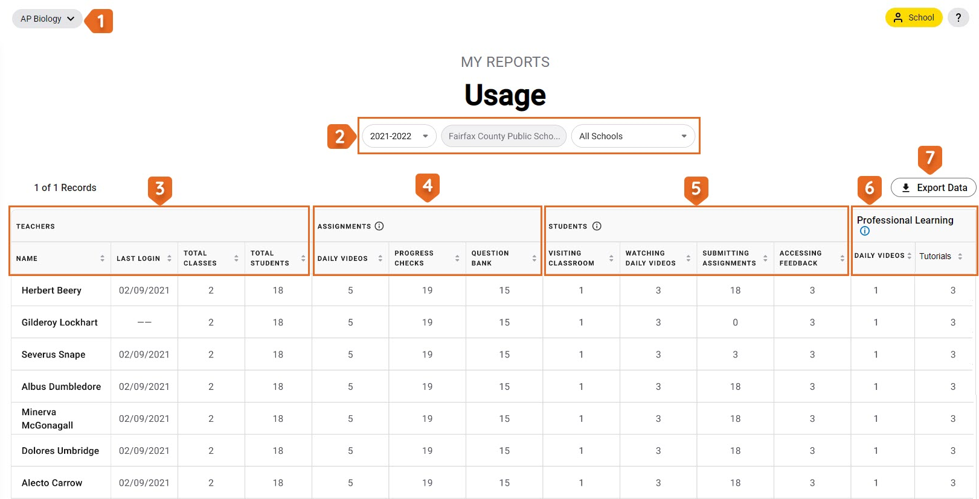
Reports: Usage

Slide 19
Reports: Usage
View how teachers in your district are using AP Classroom
Course Selection: Select another course.
Use the drop-down menus for the specific school year, districts, and schools.
Teachers: Name, last login date, number of
AP classes taught, and the number of students
who have logged in.
Assignments: How many times an AP Daily video, progress check, or question bank quiz has been assigned.
Students: How many students have visited
AP Classroom, watched a video, submitted an assignment, or reviewed feedback.
Professional Learning: The number of AP Daily videos and AP Classroom tutorials viewed by
the teacher.
Export: to Excel for whole district view.
Notes:
This report is for administrators only

Slide 20
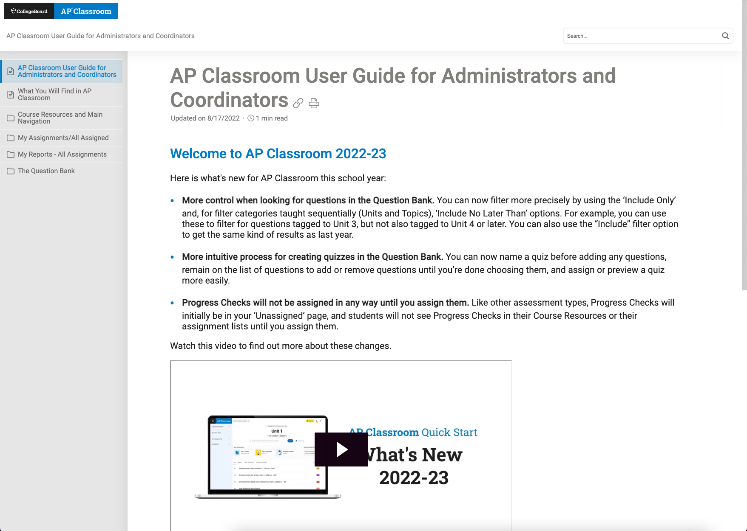
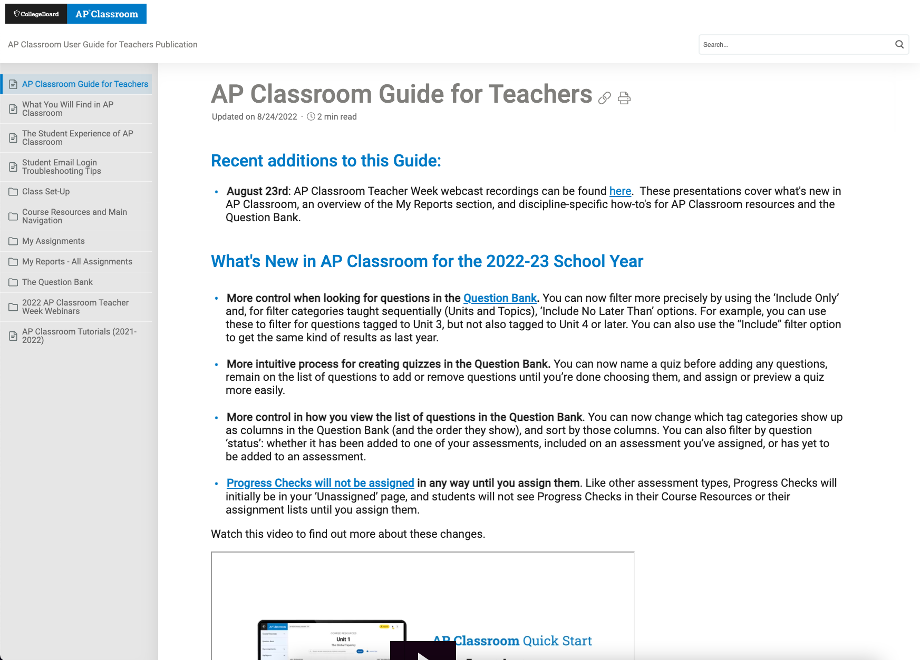
Resources
Thank you for all you do for your students. Enjoy your summer!
For detailed videos, how-tos, and step-by-step instructions, visit the AP Classroom User Guide for Administrators and Coordinators.
Encourage your teachers to access the AP Classroom User Guide for Teachers at any time for the latest walk-throughs and how-to videos, as well as to stay updated on these new features. They can also contact us using AP Classroom’s Help menu to get additional support and make suggestions for future AP Classroom enhancements.
Access AP Classroom

Slide 21
Thank You!

